Slide 1
AWS Cloud Architecture

Slide 2



How websites work
network
Client
Server
Clients have IP addresses
Servers have IP addresses

Slide 3

Just like when you’re sending post mail!

Slide 4





What is a server composed of.
Compute: CPU
Memory: RAM
+
=
Storage: Data
Database: Store data in a structured way
Network: Routers, switch, DNS server

Slide 5




IT Terminology
Network: cables, routers and servers connected with each other
Router: A networking device that forwards data packets between computer networks.They know where to send your packets on the internet!
Switch: Takes a packet and send it to the correct server / client on your network
Router
Switch

Slide 6




Traditionally, how to build infrastructure
Home or Garage
Office
Data center

Slide 7

Problems with traditional IT approach
Pay for the rent for the data center
Pay for power supply, cooling, maintenance
Adding and replacing hardware takes time
Scaling is limited
Hire 24/7 team to monitor the infrastructure
How to deal with disasters? (earthquake, power shutdown, fire…)
Can we externalize all this?

Slide 8

What is Cloud Computing?
Cloud computing is the on-demand delivery of compute power, database storage, applications, and other IT resources
Through a cloud services platform with pay-as-you-go pricing
You can provision exactly the right type and size of computing resources you need
You can access as many resources as you need, almost instantly
Simple way to access servers, storage, databases and a set of application services
Amazon Web Services owns and maintains the network-connected hardware required for these application services, while you provision and use what you need via a web application.

Slide 9


Office
The Cloud

Slide 10
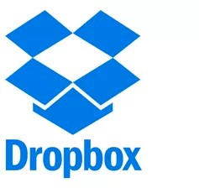


You’ve been using some Cloud services
Gmail
E-mail cloud service
Pay for ONLY your emails stored (no infrastructure, etc.)
Dropbox
Cloud Storage Service
Originally built on AWS
Netflix
Built on AWS
Video on Demand

Slide 11
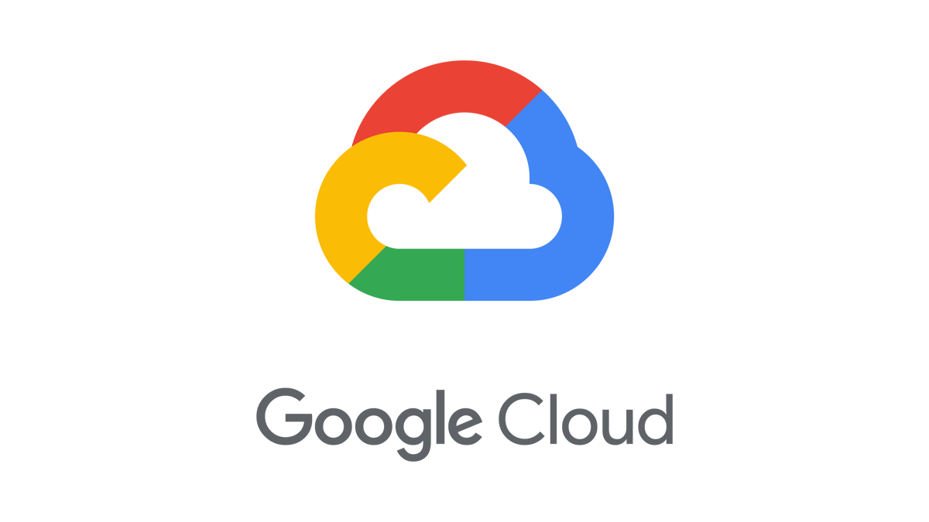





The Deployment Models of the Cloud
Private Cloud:
Cloud services used by a single organization, not exposed to the public.
Complete control
Security for sensitive applications
Meet specific business needs
Public Cloud:
Cloud resources owned and operated by a third- party cloud service provider delivered over the Internet.
Six Advantages of Cloud Computing
Hybrid Cloud:
Keep some servers on premises and extend some capabilities to the Cloud
Control over sensitive assets in your private infrastructure
Flexibility and cost- effectiveness of the public cloud

Slide 12
The Five Characteristics of Cloud Computing
On-demand self service:
Users can provision resources and use them without human interaction from the service provider
Broad network access:
Resources available over the network, and can be accessed by diverse client platforms
Multi-tenancy and resource pooling:
Multiple customers can share the same infrastructure and applications with security and privacy
Multiple customers are serviced from the same physical resources
Rapid elasticity and scalability:
Automatically and quickly acquire and dispose resources when needed
Quickly and easily scale based on demand
Measured service:
Usage is measured, users pay correctly for what they have used

Slide 13
Six Advantages of Cloud Computing
Trade capital expense (CAPEX) for operational expense (OPEX)
Pay On-Demand: don’t own hardware
Reduced Total Cost of Ownership (TCO) & Operational Expense (OPEX)
Benefit from massive economies of scale
Prices are reduced as AWS is more efficient due to large scale
Stop guessing capacity
Scale based on actual measured usage
Increase speed and agility
Stop spending money running and maintaining data centers
Go global in minutes: leverage the AWS global infrastructure

Slide 14
Problems solved by the Cloud
Flexibility: change resource types when needed
Cost-Effectiveness: pay as you go, for what you use
Scalability: accommodate larger loads by making hardware stronger or adding additional nodes
Elasticity: ability to scale out and scale-in when needed
High-availability and fault-tolerance: build across data centers
Agility: rapidly develop, test and launch software applications

Slide 15
Types of Cloud Computing
Infrastructure as a Service (IaaS)
Provide building blocks for cloud IT
Provides networking, computers, data storage space
Highest level of flexibility
Easy parallel with traditional on-premises IT
Platform as a Service (PaaS)
Removes the need for your organization to manage the underlying infrastructure
Focus on the deployment and management of your applications
Software as a Service (SaaS)
Completed product that is run and managed by the service provider

Slide 16
Infrastructure as a Service (IaaS)
Platform as a Service (PaaS)
Applications
Data Runtime Middleware O/S Virtualization
Software as a Service (SaaS)
Applications
Data Runtime Middleware O/S Virtualization
On-premises
Applications
Data Runtime Middleware O/S Virtualization
Applications
Data Runtime Middleware O/S Virtualization
Servers
Storage
Servers
Storage
Servers
Storage
Servers
Storage
Networking
Networking
Networking
Networking
Managed by you
Managed by others

Slide 17



Example of Cloud Computing Types
Infrastructure as a Service:
Amazon EC2 (on AWS)
GCP, Azure, Rackspace, Digital Ocean, Linode
Platform as a Service:
Elastic Beanstalk (on AWS)
Heroku, Google App Engine (GCP), Windows Azure (Microsoft)
Software as a Service:
Many AWS services (ex: Rekognition for Machine Learning)
Google Apps (Gmail), Dropbox, Zoom

Slide 18




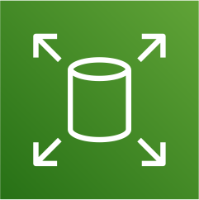



Pricing of the Cloud – Quick Overview
AWS has 3 pricing fundamentals, following the pay-as-you-go pricing model
Compute:
Pay for compute time
Storage:
Pay for data stored in the Cloud
Data transfer OUT of the Cloud:
Data transfer IN is free
Solves the expensive issue of traditional IT

Slide 19




AWS Cloud History
2002:
Internally launched
2004:
Launched publicly with SQS
2007:
Launched in Europe
2003:
Amazon infrastructure is one of their core strength.
Idea to market
2006:
Re-launched
publicly with SQS, S3 & EC2

Slide 20
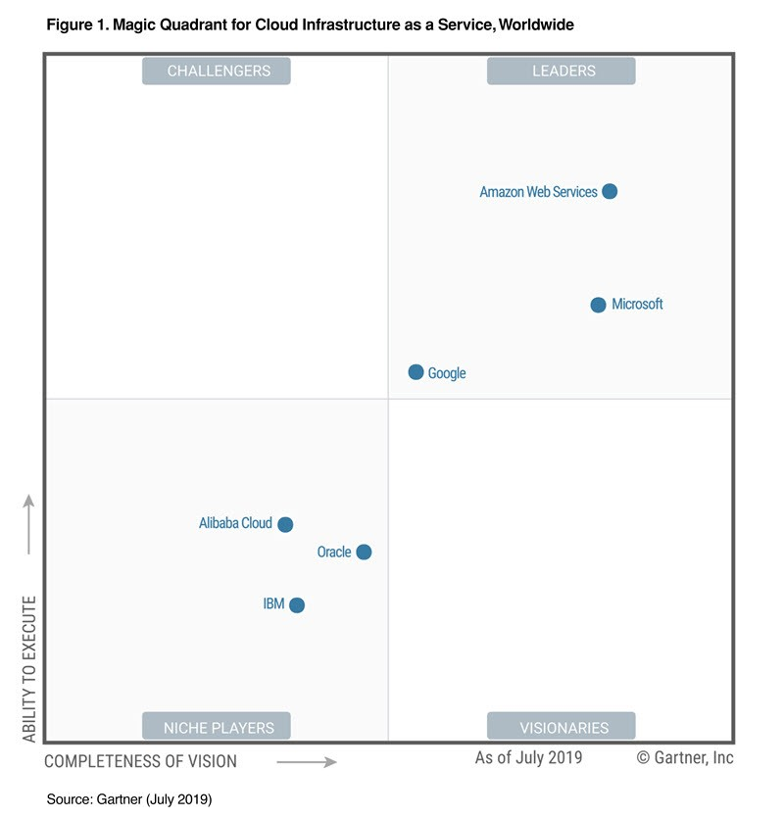
AWS Cloud Number Facts
In 2019, AWS had $35.02 billion in annual revenue
AWS accounts for 47% of the market in 2019 (Microsoft is 2nd with 22%)
Pioneer and Leader of the AWS Cloud Market for the 9th consecutive year
Over 1,000,000 active users
Gartner Magic Quadrant

Slide 21



AWS Cloud Use Cases
AWS enables you to build sophisticated, scalable applications
Applicable to a diverse set of industries
Use cases include
Enterprise IT, Backup & Storage, Big Data analytics
Website hosting, Mobile & Social Apps
Gaming

Slide 22
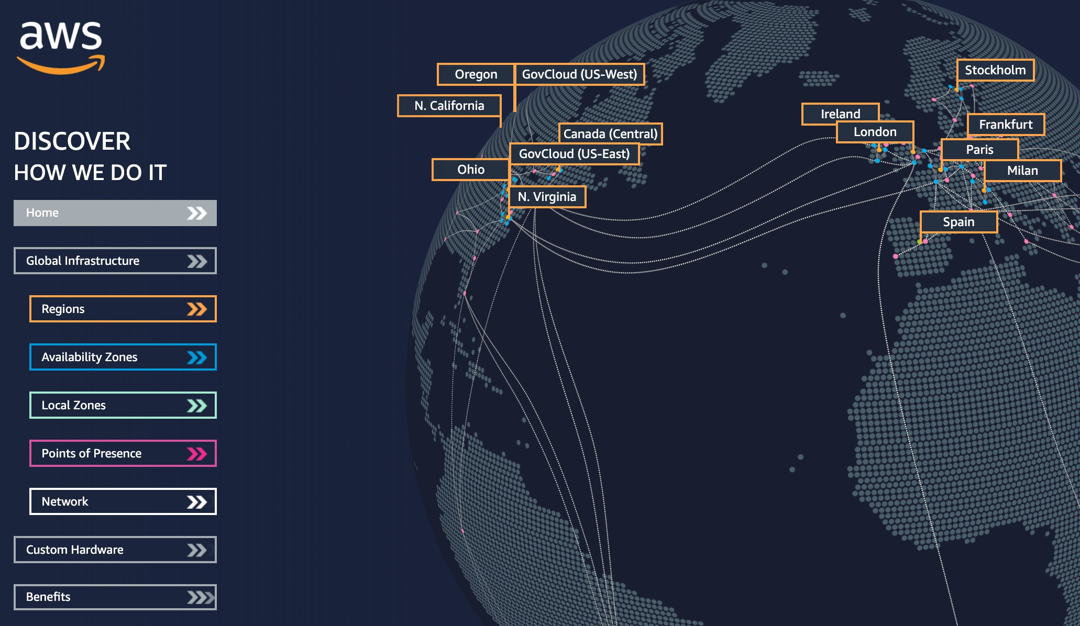
AWS Global Infrastructure
AWS Regions
AWS Availability Zones
AWS Data Centers
AWS Edge Locations / Points of Presence
https://infrastructure.aws/

Slide 23
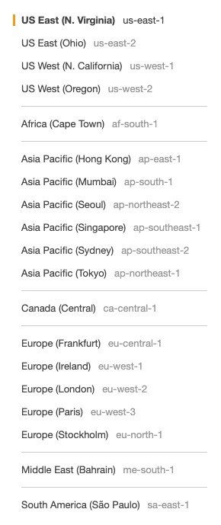
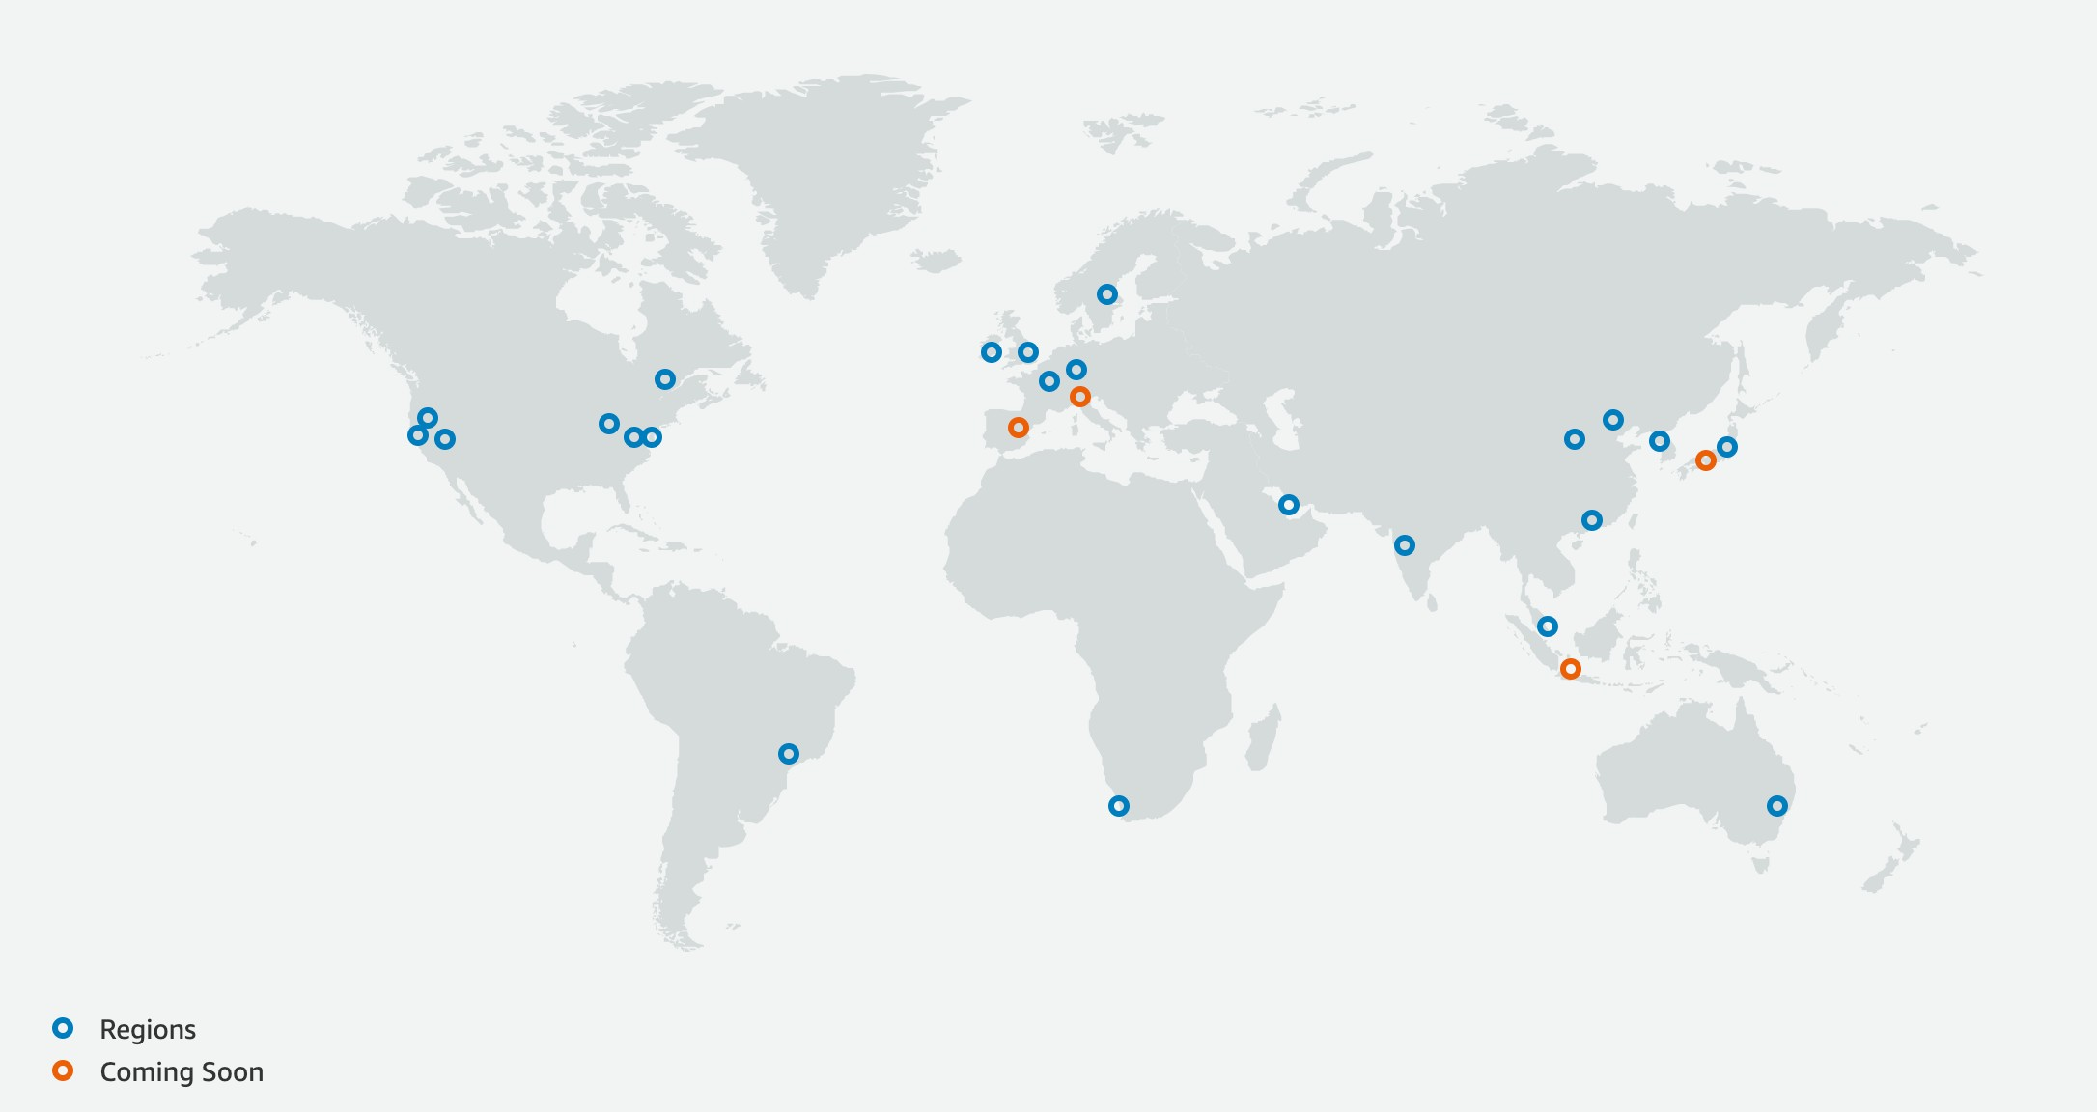
AWS Regions
AWS has Regions all around the world
Names can be us-east-1, eu-west-3…
A region is a cluster of data centers
Most AWS services are region-scoped
https://aws.amazon.com/about-aws/global-infrastructure/

Slide 24

AWS Availability Zones
Each region has many availability zones (usually 3, min is 2, max is 6). Example:
ap-southeast-2a
ap-southeast-2b
ap-southeast-2c
Each availability zone (AZ) is one or more discrete data centers with redundant power, networking, and connectivity
They’re separate from each other, so that they’re isolated from disasters
They’re connected with high bandwidth, ultra-low latency networking
AWS Region Sydney: ap-southeast-2
ap-southeast-2a
ap-southeast-2b
ap-southeast-2c

Slide 25
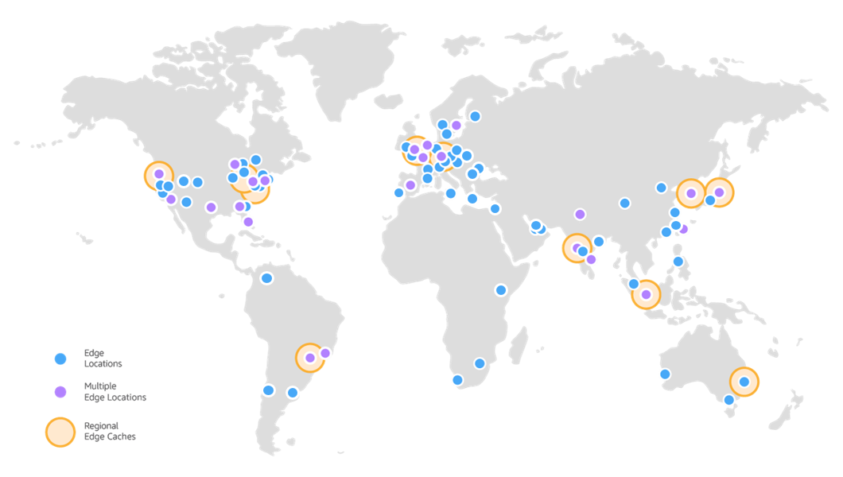
AWS Points of Presence (Edge Locations)
Amazon has 216 Points of Presence (205 Edge Locations & 11 Regional Caches) in 84 cities across 42 countries
Content is delivered to end users with lower latency
https://aws.amazon.com/cloudfront/features/

Slide 26



Tour of the AWS Console
AWS has Global Services:
Identity and Access Management (IAM)
Route 53 (DNS service)
CloudFront (Content Delivery Network)
WAF (Web Application Firewall)
Most AWS services are Region-scoped:
Amazon EC2 (Infrastructure as a Service)
Elastic Beanstalk (Platform as a Service)
Lambda (Function as a Service)
Rekognition (Software as a Service)
Region Table: https://aws.amazon.com/about-aws/global-infrastructure/regional-product-services

Slide 27
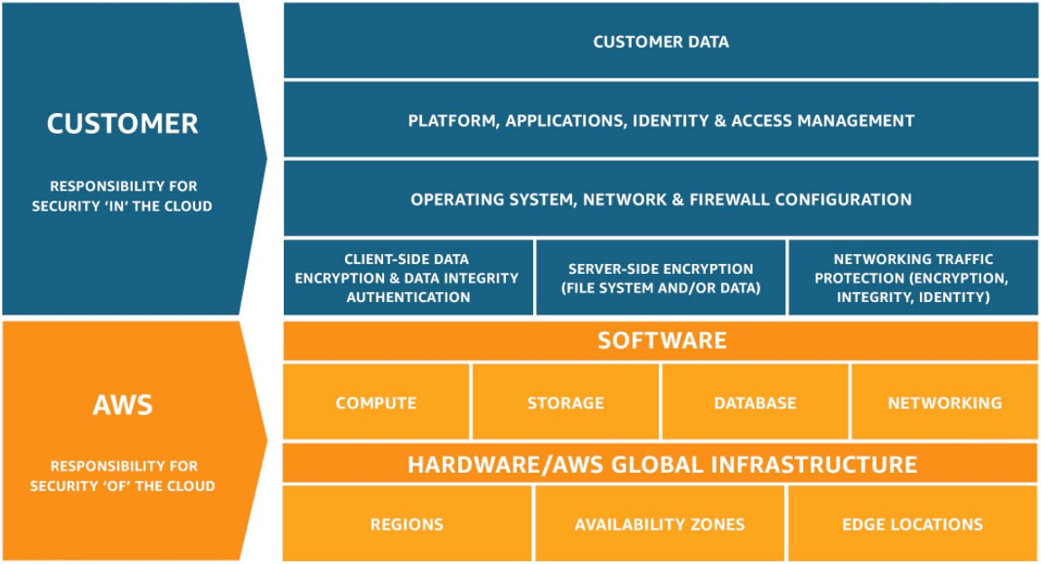
Shared Responsibility Model diagram
CUSTOMER = RESPONSIBILITY FOR THE SECURITY IN THE CLOUD
AWS = RESPONSIBILITY FOR THE SECURITY OF THE CLOUD
https://aws.amazon.com/compliance/shared-responsibility-model/

Slide 28
AWS Acceptable Use Policy
https://aws.amazon.com/aup/
No Illegal, Harmful, or Offensive Use or Content
No Security Violations
No Network Abuse
No E-Mail or Other Message Abuse

Slide 29
IAM Section

Slide 30







IAM: Users & Groups
IAM = Identity and Access Management, Global service
Root account created by default, shouldn’t be used or shared
Users are people within your organization, and can be grouped
Groups only contain users, not other groups
Users don’t have to belong to a group, and user can belong to multiple groups
Group: Developers
Group: Operations
Group Audit Team
Alice
Bob
Charles
David
Edward
Fred

Slide 31

IAM: Permissions
{
"Version": "2012-10-17",
"Statement": [
{
"Effect": "Allow", "Action": "ec2:Describe*", "Resource": "*"
},
{
"Effect": "Allow",
"Action": "elasticloadbalancing:Describe*", "Resource": "*"
},
{
"Effect": "Allow", "Action": [
"cloudwatch:ListMetrics",
"cloudwatch:GetMetricStatistics", "cloudwatch:Describe*"
],
"Resource": "*"
}
]
}
Users or Groups can be assigned JSON documents called policies
These policies define the
permissions of the users
In AWS you apply the least privilege principle: don’t give more permissions than a user needs

Slide 32




IAM Policies
Audit Team
Developers
Operations
Alice
Bob
Charles
David
Edward
Fred

Slide 33
IAM – Password Policy
Strong passwords = higher security for your account
In AWS, you can setup a password policy:
Set a minimum password length
Require specific character types:
including uppercase letters
lowercase letters
numbers
non-alphanumeric characters
Allow all IAM users to change their own passwords
Require users to change their password after some time (password expiration)
Prevent password re-use

Slide 34



Multi Factor Authentication - MFA
Users have access to your account and can possibly change configurations or delete resources in your AWS account
You want to protect your Root Accounts and IAM users
MFA = password you know + security device you own
+
=>
Password
Successful login
Alice
Main benefit of MFA:
if a password is stolen or hacked, the account is not compromised

Slide 35
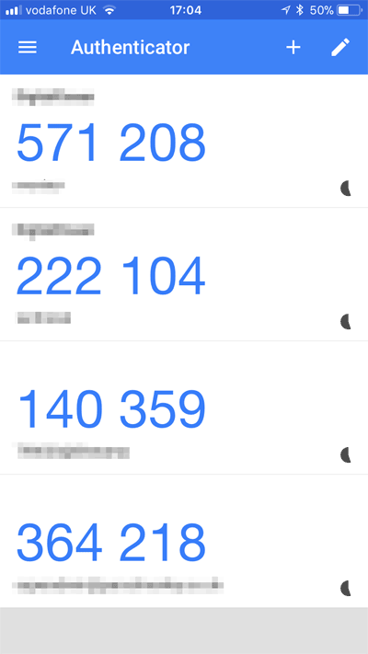
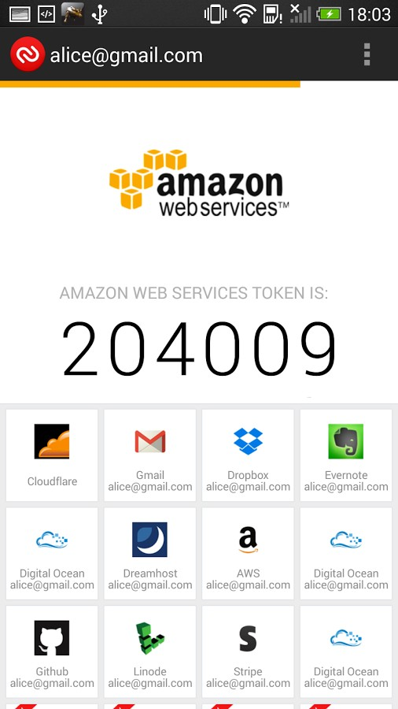

MFA devices options in AWS
Virtual MFA device Universal 2nd Factor (U2F) Security Key
Google Authenticator
(phone only)
Authy
(multi-device)
YubiKey by Yubico (3rd party)
Support for multiple tokens on a single device.
Support for multiple root and IAM users using a single security key

Slide 36

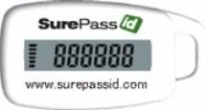
MFA devices options in AWS
Hardware Key Fob MFA Device
Hardware Key Fob MFA Device for AWS GovCloud (US)
Provided by Gemalto (3rd party)
Provided by SurePassID (3rd party)

Slide 37

How can users access AWS ?
To access AWS, you have three options:
AWS Management Console (protected by password + MFA)
AWS Command Line Interface (CLI): protected by access keys
AWS Software Developer Kit (SDK) - for code: protected by access keys
Access Keys are generated through the AWS Console
Users manage their own access keys
Access Keys are secret, just like a password. Don’t share them
Access Key ID ~= username
Secret Access Key ~= password

Slide 38
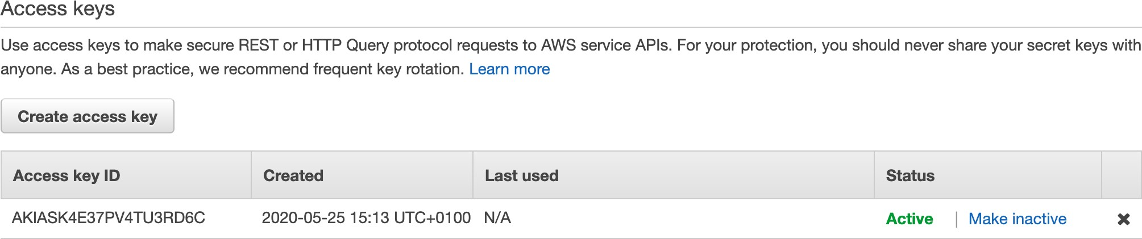
Example (Fake) Access Keys
Access key ID: AKIASK4E37PV4983d6C
Secret Access Key: AZPN3zojWozWCndIjhB0Unh8239a1bzbzO5fqqkZq
Remember: don’t share your access keys

Slide 39




IAM Roles for Services
Some AWS service will need to perform actions on your behalf
To do so, we will assign permissions to AWS services with IAM Roles
Common roles:
EC2 Instance Roles
Lambda Function Roles
Roles for CloudFormation
IAM Role
EC2 Instance (virtual server)
Access AWS

Slide 40
IAM Security Tools
IAM Credentials Report (account-level)
a report that lists all your account's users and the status of their various credentials
IAM Access Advisor (user-level)
Access advisor shows the service permissions granted to a user and when those services were last accessed.
You can use this information to revise your policies.

Slide 41
IAM Guidelines & Best Practices
Don’t use the root account except for AWS account setup
One physical user = One AWS user
Assign users to groups and assign permissions to groups
Create a strong password policy
Use and enforce the use of Multi Factor Authentication (MFA)
Create and use Roles for giving permissions to AWS services
Use Access Keys for Programmatic Access (CLI / SDK)
Audit permissions of your account with the IAM Credentials Report
Never share IAM users & Access Keys

Slide 42


Shared Responsibility Model for IAM
You
Users, Groups, Roles, Policies management and monitoring
Enable MFA on all accounts
Rotate all your keys often
Use IAM tools to apply appropriate permissions
Analyze access patterns & review permissions
Infrastructure (global network security)
Configuration and vulnerability analysis
Compliance validation

Slide 43
IAM Section – Summary
Users: mapped to a physical user, has a password for AWS Console
Groups: contains users only
Policies: JSON document that outlines permissions for users or groups
Roles: for EC2 instances or AWS services
Security: MFA + Password Policy
Access Keys: access AWS using the CLI or SDK
Audit: IAM Credential Reports & IAM Access Advisor

Slide 44
EC2 Section

Slide 45

Amazon EC2
EC2 is one of the most popular of AWS’ offering
EC2 = Elastic Compute Cloud = Infrastructure as a Service
It mainly consists in the capability of :
Renting virtual machines (EC2)
Storing data on virtual drives (EBS)
Distributing load across machines (ELB)
Scaling the services using an auto-scaling group (ASG)
Knowing EC2 is fundamental to understand how the Cloud works

Slide 46
EC2 sizing & configuration options
Operating System (OS): Linux or Windows
How much compute power & cores (CPU)
How much random-access memory (RAM)
How much storage space:
Network-attached (EBS & EFS)
hardware (EC2 Instance Store)
Network card: speed of the card, Public IP address
Firewall rules: security group
Bootstrap script (configure at first launch): EC2 User Data

Slide 47
EC2 instance types: example
Instance | vCPU | Mem (GiB) | Storage | Network Performance | EBS Bandwidth (Mbps)
t2.micro | 1 | 1 | EBS-Only | Low to Moderate
t2.xlarge | 4 | 16 | EBS-Only | Moderate
c5d.4xlarge | 16 | 32 | 1 x 400 NVMe SSD | Up to 10 Gbps | 4,750
r5.16xlarge | 64 | 512 | EBS Only | 20 Gbps | 13,600
m5.8xlarge | 32 | 128 | EBS Only | 10 Gbps | 6,800
t2.micro is part of the AWS free tier (up to 750 hours per month)

Slide 48
Hands-On:
Launching an EC2 Instance running Linux
We’ll be launching our first virtual server using the AWS Console
We’ll get a first high-level approach to the various parameters
We’ll see that our web server is launched using EC2 user data
We’ll learn how to start / stop / terminate our instance.

Slide 49


Introduction to Security Groups
Security Groups are the fundamental of network security in AWS
They control how traffic is allowed into or out of our EC2 Instances.
Inbound traffic Outbound traffic
EC2 Instance
Security Group
WWW
Security groups only contain rules
Security groups rules can reference by IP or by security group

Slide 50
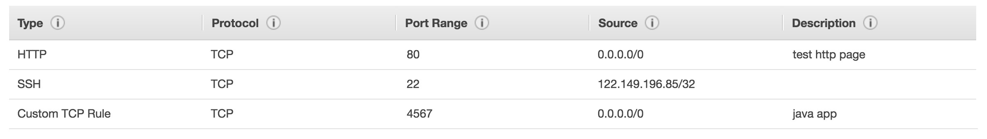
Security Groups Deeper Dive
Security groups are acting as a “firewall” on EC2 instances
They regulate:
Access to Ports
Authorised IP ranges – IPv4 and IPv6
Control of inbound network (from other to the instance)
Control of outbound network (from the instance to other)

Slide 51
Security Groups Diagram
Security Group 1 Inbound
Filter IP / Port with Rules
Your Computer - IP XX.XX.XX.XX (authorised port 22)
Port 22
Port 22
Other computer (not authorised port 22)
EC2 Instance IP XX.XX.XX.XX
Security Group 1 Outbound
Filter IP / Port with Rules
WWW
Any IP – Any Port
Any Port

Slide 52
Classic Ports to know
22 = SSH (Secure Shell) - log into a Linux instance
21 = FTP (File Transport Protocol) – upload files into a file share
22 = SFTP (Secure File Transport Protocol) – upload files using SSH
80 = HTTP – access unsecured websites
443 = HTTPS – access secured websites
3389 = RDP (Remote Desktop Protocol) – log into a Windows instance

Slide 53

SSH Summary Table
SSH
Putty
EC2 Instance Connect
Mac
Linux
Windows < 10
Windows >= 10

Slide 54
Which Lectures to watch
Mac / Linux:
SSH on Mac/Linux lecture
Windows:
Putty Lecture
If Windows 10: SSH on Windows 10 lecture
All:
EC2 Instance Connect lecture

Slide 55
SSH troubleshooting
Students have the most problems with SSH
If things don’t work…
Re-watch the lecture.You may have missed something
Read the troubleshooting guide
Try EC2 Instance Connect
If one method works (SSH, Putty or EC2 Instance Connect) you’re good
If no method works, that’s okay, the course won’t use SSH much

Slide 56

How to SSH into your EC2 Instance Linux / Mac OS X
We’ll learn how to SSH into your EC2 instance using Linux / Mac
SSH is one of the most important function. It allows you to control a remote machine, all using the command line.
EC2 Instance Linux
Public IP
SSH – Port 22
WWW
We will see how we can configure OpenSSH ~/.ssh/config to facilitate the SSH into our EC2 instances

Slide 57
How to SSH into your EC2 Instance Windows
We’ll learn how to SSH into your EC2 instance using Windows
SSH is one of the most important function. It allows you to control a remote machine, all using the command line.
EC2 Instance Linux
Public IP
SSH – Port 22
WWW
We will configure all the required parameters necessary for doing SSH on Windows using the free tool Putty.

Slide 58
EC2 Instance Connect
Connect to your EC2 instance within your browser
No need to use your key file that was downloaded
The “magic” is that a temporary key is uploaded onto EC2 by AWS
Works only out-of-the-box with Amazon Linux 2
Need to make sure the port 22 is still opened!

Slide 59
EC2 Instances Purchasing Options
On-Demand Instances: short workload, predictable pricing
Reserved: (MINIMUM 1 year)
Reserved Instances: long workloads
Convertible Reserved Instances: long workloads with flexible instances
Scheduled Reserved Instances: example – every Thursday between 3 and 6 pm
Spot Instances: short workloads, cheap, can lose instances (less reliable)
Dedicated Hosts: book an entire physical server, control instance placement
Dedicated Instances: no other customers will share your hardware

Slide 60
EC2 On Demand
Pay for what you use:
Linux - billing per second, after the first minute
All other operating systems (ex: Windows) - billing per hour
Has the highest cost but no upfront payment
No long-term commitment
Recommended for short-term and un-interrupted workloads, where you can't predict how the application will behave

Slide 61
EC2 Reserved Instances
Up to 72% discount compared to On-demand
Reservation period: 1 year = + discount | 3 years = +++ discount
Purchasing options: no upfront | partial upfront = + | All upfront = ++ discount
Reserve a specific instance type
Recommended for steady-state usage applications (think database)
Convertible Reserved Instance
can change the EC2 instance type
Up to 45% discount
Scheduled Reserved Instances
launch within time window you reserve
When you require a fraction of day / week / month
Commitment for 1 year only

Slide 62

EC2 Spot Instances
Can get a discount of up to 90% compared to On-demand
Instances that you can “lose” at any point of time if your max price is less than the current spot price
The MOST cost-efficient instances in AWS
Useful for workloads that are resilient to failure
Batch jobs
Data analysis
Image processing
Any distributed workloads
Workloads with a flexible start and end time
Not suitable for critical jobs or databases

Slide 63
EC2 Dedicated Hosts
An Amazon EC2 Dedicated Host is a physical server with EC2 instance capacity fully dedicated to your use. Dedicated Hosts can help you address compliance requirements and reduce costs by allowing you to use your existing server-bound software licenses.
Allocated for your account for a 3-year period reservation
More expensive
Useful for software that have complicated licensing model (BYOL – Bring Your Own License)
Or for companies that have strong regulatory or compliance needs

Slide 64
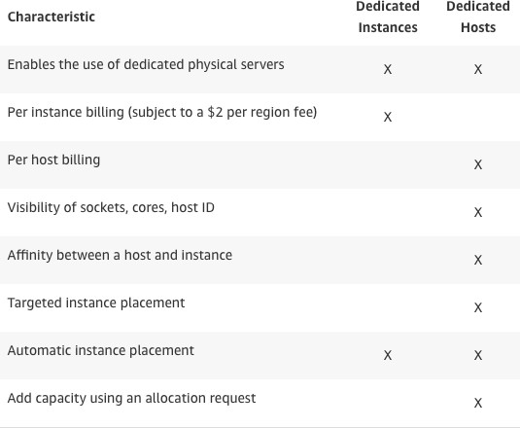
EC2 Dedicated Instances
Instances running on hardware that’s dedicated to you
May share hardware with other instances in same account
No control over instance placement (can move hardware after Stop / Start)

Slide 65

Which purchasing option is right for me?
On demand: coming and staying in resort whenever we like, we pay the full price
Reserved: like planning ahead and if we plan to stay for a long time, we may get a good discount.
Spot instances: the hotel allows people to bid for the empty rooms and the highest bidder keeps the rooms.You can get kicked out at any time
Dedicated Hosts: We book an entire building of the resort

Slide 66
Price Comparison
Example – m4.large – us-east-1
Price Type | Price (per hour)
On-demand | $0.10
Spot Instance (Spot Price) | $0.032 - $0.045 (up to 90% off)
Spot Block (1 to 6 hours) | ~ Spot Price
Reserved Instance (12 months) – no upfront | $0.062
Reserved Instance (12 months) – all upfront | $0.058
Reserved Instance (36 months) – no upfront | $0.043
Reserved Convertible Instance (12 months) – no upfront | $0.071
Reserved Scheduled Instance (recurring schedule on 12 months term) | $0.090 – $0.095 (5%-10% off)
Dedicated Host | On-demand price
Dedicated Host Reservation | Up to 70% off

Slide 67
Shared Responsibility Model for EC2
Infrastructure (global network security)
Isolation on physical hosts
Replacing faulty hardware
Compliance validation
Security Groups rules
Operating-system patches and updates
Software and utilities installed on the EC2 instance
IAM Roles assigned to EC2 & IAM user access management
Data security on your instance

Slide 68
EC2 Section – Summary
EC2 Instance: AMI (OS) + Instance Size (CPU + RAM) + Storage + security groups + EC2 User Data
Security Groups: Firewall attached to the EC2 instance
EC2 User Data: Script launched at the first start of an instance
SSH: start a terminal into our EC2 Instances (port 22)
EC2 Instance Role: link to IAM roles
Purchasing Options: On-Demand, Spot, Reserved (Standard + Convertible + Scheduled), Dedicated Host, Dedicated Instance

Slide 69
EC2 Instance Storage Section

Slide 70
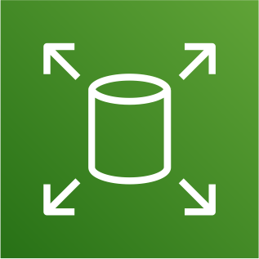
What’s an EBS Volume?
An EBS (Elastic Block Store) Volume is a network drive you can attach to your instances while they run
It allows your instances to persist data, even after their termination
They can only be mounted to one instance at a time (at the CCP level)
They are bound to a specific availability zone
Analogy:Think of them as a “network USB stick”
Free tier: 30 GB of free EBS storage of type gp2 per month

Slide 71
EBS Volume
It’s a network drive (i.e. not a physical drive)
It uses the network to communicate the instance, which means there might be a bit of latency
It can be detached from an EC2 instance and attached to another one quickly
It’s locked to an Availability Zone (AZ)
An EBS Volume in us-east-1a cannot be attached to us-east-1b
To move a volume across, you first need to snapshot it
Have a provisioned capacity (size in GBs, and IOPS)
You get billed for all the provisioned capacity
You can increase the capacity of the drive over time

Slide 72








EBS Volume - Example
US-EAST-1A
US-EAST-1B
EBS (10 GB)
EBS (100 GB)
EBS (50 GB)
EBS (50 GB)
EBS (10 GB)
unattached

Slide 73





EBS Snapshots
Make a backup (snapshot) of your EBS volume at a point in time
Not necessary to detach volume to do snapshot, but recommended
Can copy snapshots across AZ or Region
US-EAST-1A
US-EAST-1B
EBS Snapshot
EBS (50 GB)
snapshot
restore
EBS (50 GB)

Slide 74

AMI Overview
AMI = Amazon Machine Image
AMI are a customization of an EC2 instance
You add your own software, configuration, operating system, monitoring…
Faster boot / configuration time because all your software is pre-packaged
AMI are built for a specific region (and can be copied across regions)
You can launch EC2 instances from:
A Public AMI: AWS provided
Your own AMI: you make and maintain them yourself
An AWS Marketplace AMI: an AMI someone else made (and potentially sells)

Slide 75



AMI Process (from an EC2 instance)
Start an EC2 instance and customize it
Stop the instance (for data integrity)
Build an AMI – this will also create EBS snapshots
Launch instances from other AMIs
Custom AMI
US-EAST-1A
US-EAST-1B
Launch from AMI
Create AMI

Slide 76

EC2 Instance Store
EBS volumes are network drives with good but “limited” performance
If you need a high-performance hardware disk, use EC2 Instance Store
Better I/O performance
EC2 Instance Store lose their storage if they’re stopped (ephemeral)
Good for buffer / cache / scratch data / temporary content
Risk of data loss if hardware fails
Backups and Replication are your responsibility

Slide 77
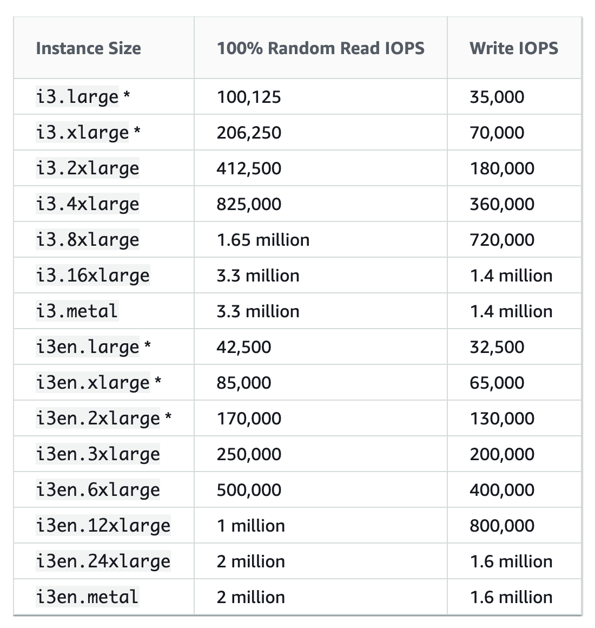
Local EC2 Instance Store
Very high IOPS

Slide 78
EFS – Elastic File System
Managed NFS (network file system) that can be mounted on 100s of EC2
EFS works with Linux EC2 instances in multi-AZ
Highly available, scalable, expensive (3x gp2), pay per use, no capacity planning
EC2
us-east-1a
EC2
us-east-1b
EC2
us-east-1c
Security Group
EFS

Slide 79









EBS vs EFS
Availability Zone 1
EBS
Availability Zone 2
EBS
Availability Zone 1
Availability Zone 2
EFS
Mount Target
EFS
Mount Target
snapshot
restore
EBS Snapshot
EFS

Slide 80
Shared Responsibility Model for EC2 Storage
Infrastructure
Replication for data for EBS volumes & EFS drives
Replacing faulty hardware
Ensuring their employees cannot access your data
Setting up backup / snapshot procedures
Setting up data encryption
Responsibility of any data on the drives
Understanding the risk of using EC2 Instance Store

Slide 81
EC2 Instance Storage - Summary
EBS volumes:
network drives attached to one EC2 instance at a time
Mapped to an Availability Zones
Can use EBS Snapshots for backups / transferring EBS volumes across AZ
AMI: create ready-to-use EC2 instances with our customizations
EC2 Instance Store:
High performance hardware disk attached to our EC2 instance
Lost if our instance is stopped / terminated
EFS: network file system, can be attached to 100s of instances in a region

Slide 82
Elastic Load Balancing & Auto Scaling Groups Section

Slide 83
Scalability & High Availability
Scalability means that an application / system can handle greater loads by adapting.
There are two kinds of scalability:
Vertical Scalability
Horizontal Scalability (= elasticity)
Scalability is linked but different to High Availability
Let’s deep dive into the distinction, using a call center as an example

Slide 84


Vertical Scalability
Vertical Scalability means increasing the size of the instance
For example, your application runs on a t2.micro
Scaling that application vertically means running it on a t2.large
Vertical scalability is very common for non distributed systems, such as a database.
There’s usually a limit to how much you can vertically scale (hardware limit)
junior operator
senior operator

Slide 85
Horizontal Scalability
operator
operator
operator
Horizontal Scalability means increasing the number of instances / systems for your application
Horizontal scaling implies distributed systems.
This is very common for web applications / modern applications
It’s easy to horizontally scale thanks the cloud offerings such as Amazon EC2
operator
operator
operator

Slide 86
High Availability
first building in New York
High Availability usually goes hand in hand with horizontal scaling
High availability means running your application / system in at least 2 Availability Zones
The goal of high availability is to survive a data center loss (disaster)
second building in San Francisco

Slide 87
High Availability & Scalability For EC2
Vertical Scaling: Increase instance size (= scale up / down)
From: t2.nano - 0.5G of RAM, 1 vCPU
To: u-12tb1.metal – 12.3 TB of RAM, 448 vCPUs
Horizontal Scaling: Increase number of instances (= scale out / in)
Auto Scaling Group
Load Balancer
High Availability: Run instances for the same application across multi AZ
Auto Scaling Group multi AZ
Load Balancer multi AZ

Slide 88
Scalability vs Elasticity (vs Agility)
Scalability: ability to accommodate a larger load by making the hardware stronger (scale up), or by adding nodes (scale out)
Elasticity: once a system is scalable, elasticity means that there will be some “auto-scaling” so that the system can scale based on the load.This is “cloud-friendly”: pay-per-use, match demand, optimize costs
Agility: (not related to scalability - distractor) new IT resources are only a click away, which means that you reduce the time to make those resources available to your developers from weeks to just minutes.

Slide 89





What is load balancing?
Load balancers are servers that forward internet traffic to multiple servers (EC2 Instances) downstream.
Load Balancer
User 1
User 2
User 3

Slide 90
Why use a load balancer?
Spread load across multiple downstream instances
Expose a single point of access (DNS) to your application
Seamlessly handle failures of downstream instances
Do regular health checks to your instances
Provide SSL termination (HTTPS) for your websites
High availability across zones

Slide 91
Why use an Elastic Load Balancer?
An ELB (Elastic Load Balancer) is a managed load balancer
AWS guarantees that it will be working
AWS takes care of upgrades, maintenance, high availability
AWS provides only a few configuration knobs
It costs less to setup your own load balancer but it will be a lot more effort on your end (maintenance, integrations)
3 kinds of load balancers offered by AWS:
Application Load Balancer (HTTP / HTTPS only) – Layer 7
Network Load Balancer (ultra-high performance, allows for TCP) – Layer 4
Classic Load Balancer (slowly retiring) – Layer 4 & 7

Slide 92

What’s an Auto Scaling Group?
In real-life, the load on your websites and application can change
In the cloud, you can create and get rid of servers very quickly
The goal of an Auto Scaling Group (ASG) is to:
Scale out (add EC2 instances) to match an increased load
Scale in (remove EC2 instances) to match a decreased load
Ensure we have a minimum and a maximum number of machines running
Automatically register new instances to a load balancer
Replace unhealthy instances
Cost Savings: only run at an optimal capacity (principle of the cloud)

Slide 93
Auto Scaling Group in AWS
Maximum size
Actual Size / Desired Capacity
Minimum size
Scale Out as Needed
EC2
Instance
EC2
Instance
EC2
Instance
EC2
Instance
EC2
Instance
EC2
Instance
AUTO SCALING GROUP

Slide 94

Auto Scaling Group in AWS With Load Balancer
Web Traffic
Load Balancer
EC2
Instance
EC2
Instance
EC2
Instance
EC2
Instance
EC2
Instance
EC2
Instance
AUTO SCALING GROUP

Slide 95
ELB & ASG – Summary
High Availability vs Scalability (vertical and horizontal) vs Elasticity vs
Agility in the Cloud
Elastic Load Balancers (ELB)
Distribute traffic across backend EC2 instances, can be Multi-AZ
Supports health checks
3 types: Application LB (HTTP – L7), Network LB (TCP – L4), Classic LB (old)
Auto Scaling Groups (ASG)
Implement Elasticity for your application, across multiple AZ
Scale EC2 instances based on the demand on your system, replace unhealthy
Integrated with the ELB

Slide 96
Amazon S3 Section

Slide 97

Section introduction
Amazon S3 is one of the main building blocks of AWS
It’s advertised as ”infinitely scaling” storage
Many websites use Amazon S3 as a backbone
Many AWS services uses Amazon S3 as an integration as well
We’ll have a step-by-step approach to S3
The CCP exam requires “deeper” knowledge about S3

Slide 98


S3 Use cases
Backup and storage
Disaster Recovery
Archive
Hybrid Cloud storage
Application hosting
Media hosting
Data lakes & big data analytics
Software delivery
Static website
Nasdaq stores 7 years of data into S3 Glacier
Sysco runs analytics on its data and gain business insights

Slide 99

Amazon S3 Overview - Buckets
Amazon S3 allows people to store objects (files) in “buckets” (directories)
Buckets must have a globally unique name (across all regions all accounts)
Buckets are defined at the region level
S3 looks like a global service but buckets are created in a region
Naming convention
No uppercase
No underscore
3-63 characters long
Not an IP
Must start with lowercase letter or number

Slide 100

Amazon S3 Overview - Objects
Objects (files) have a Key
The key is the FULL path:
s3://my-bucket/my_file.txt
s3://my-bucket/my_folder1/another_folder/my_file.txt
The key is composed of prefix + object name
s3://my-bucket/my_folder1/another_folder/my_file.txt
There’s no concept of “directories” within buckets (although the UI will trick you to think otherwise)
Just keys with very long names that contain slashes (“/”)

Slide 101
Amazon S3 Overview – Objects (continued)
Object values are the content of the body:
Max Object Size is 5TB (5000GB)
If uploading more than 5GB, must use “multi-part upload”
Metadata (list of text key / value pairs – system or user metadata)
Tags (Unicode key / value pair – up to 10) – useful for security / lifecycle
Version ID (if versioning is enabled)

Slide 102
S3 Security
User based
IAM policies - which API calls should be allowed for a specific user from IAM console
Resource Based
Bucket Policies - bucket wide rules from the S3 console - allows cross account
Object Access Control List (ACL) – finer grain
Bucket Access Control List (ACL) – less common
Note: an IAM principal can access an S3 object if
the user IAM permissions allow it OR the resource policy ALLOWS it
AND there’s no explicit DENY
Encryption: encrypt objects in Amazon S3 using encryption keys

Slide 103



Example: Public Access - Use Bucket Policy
S3 Bucket Policy Allows Public Access
Anonymous www website visitor
S3 Bucket

Slide 104



Example: User Access to S3 – IAM permissions
IAM Policy
IAM User
S3 Bucket

Slide 105




Example: EC2 instance access - Use IAM Roles
EC2 Instance Role
IAM permissions
EC2 Instance
S3 Bucket

Slide 106

Advanced: Cross-Account Access – Use Bucket Policy
S3 Bucket Policy Allows Cross-Account
IAM User
Other AWS account
S3 Bucket

Slide 107
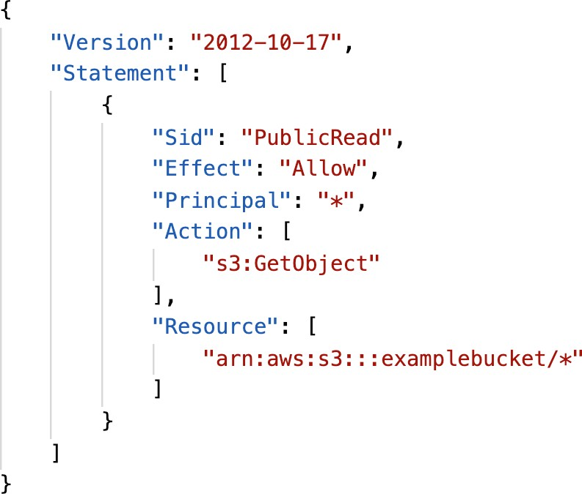
S3 Bucket Policies
JSON based policies
Resources: buckets and objects
Actions: Set of API to Allow or Deny
Effect: Allow / Deny
Principal:The account or user to apply the policy to
Use S3 bucket for policy to:
Grant public access to the bucket
Force objects to be encrypted at upload
Grant access to another account (Cross Account)

Slide 108
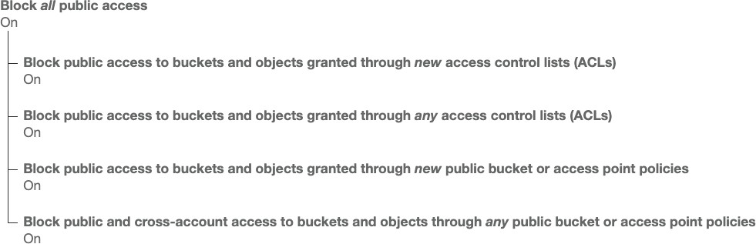
Bucket settings for Block Public Access
These settings were created to prevent company data leaks
If you know your bucket should never be public, leave these on
Can be set at the account level

Slide 109
S3 Websites
S3 can host static websites and have them accessible on the www
The website URL will be:
<bucket-name>.s3-website-<AWS-region>.amazonaws.com OR
<bucket-name>.s3-website.<AWS-region>.amazonaws.com
If you get a 403 (Forbidden) error, make sure the bucket policy allows public reads!

Slide 110

Amazon S3 - Versioning
You can version your files in Amazon S3
It is enabled at the bucket level
Same key overwrite will increment the “version”: 1, 2, 3….
It is best practice to version your buckets
Protect against unintended deletes (ability to restore a version)
Easy roll back to previous version
Notes:
Any file that is not versioned prior to enabling versioning will have version “null”
Suspending versioning does not delete the previous versions

Slide 111



S3 Access Logs
For audit purpose, you may want to log all access to S3 buckets
Any request made to S3, from any account, authorized or denied, will be logged into another S3 bucket
That data can be analyzed using data analysis tools…
requests
My-bucket
Log all requests
Very helpful to come down to the root cause of an issue, or audit usage, view suspicious patterns, etc…
Logging Bucket

Slide 112


S3 Replication (CRR & SRR)
Must enable versioning in source and destination
Cross Region Replication (CRR)
Same Region Replication (SRR)
Buckets can be in different accounts
Copying is asynchronous
Asynchronous replication
Must give proper IAM permissions to S3
eu-west-1
us-east-1
CRR - Use cases: compliance, lower latency access, replication across accounts
SRR – Use cases: log aggregation, live replication between production and test accounts

Slide 113
S3 Storage Classes
Amazon S3 Standard - General Purpose
Amazon S3 Standard-Infrequent Access (IA)
Amazon S3 One Zone-Infrequent Access
Amazon S3 Intelligent Tiering
Amazon Glacier
Amazon Glacier Deep Archive
Amazon S3 Reduced Redundancy Storage (deprecated - omitted)

Slide 114
S3 Durability and Availability
Durability:
High durability (99.999999999%, 11 9’s) of objects across multiple AZ
If you store 10,000,000 objects with Amazon S3, you can on average expect to incur a loss of a single object once every 10,000 years
Same for all storage classes
Availability:
Measures how readily available a service is
S3 standard has 99.99% availability, which means it will not be available 53 minutes a year
Varies depending on storage class

Slide 115
S3 Standard – General Purposes
99.99% Availability
Used for frequently accessed data
Low latency and high throughput
Sustain 2 concurrent facility failures
Use Cases: Big Data analytics, mobile & gaming applications, content distribution…

Slide 116
S3 Standard – Infrequent Access (IA)
Suitable for data that is less frequently accessed, but requires rapid access when needed
99.9% Availability
Lower cost compared to Amazon S3 Standard, but retrieval fee
Sustain 2 concurrent facility failures
Use Cases: As a data store for disaster recovery, backups…

Slide 117
S3 Intelligent-Tiering
99.9% Availability
Same low latency and high throughput performance of S3 Standard
Cost-optimized by automatically moving objects between two access tiers based on changing access patterns:
Frequent access
Infrequent access
Resilient against events that impact an entire Availability Zone

Slide 118
S3 One Zone - Infrequent Access (IA)
Same as IA but data is stored in a single AZ
99.5% Availability
Low latency and high throughput performance
Lower cost compared to S3-IA (by 20%)
Use Cases: Storing secondary backup copies of on-premise data, or storing data you can recreate

Slide 119

Amazon Glacier & Glacier Deep Archive
Low cost object storage (in GB/month) meant for archiving / backup
Data is retained for the longer term (years)
Various retrieval options of time + fees for retrieval:
Amazon Glacier – cheap:
Expedited (1 to 5 minutes)
Standard (3 to 5 hours)
Bulk (5 to 12 hours)
Amazon Glacier Deep Archive – cheapest:
Standard (12 hours)
Bulk (48 hours)

Slide 120
S3 Storage Classes Comparison
 | S3 Standard | S3 Intelligent- Tiering | S3 Standard-IA | S3 One Zone-IA | S3 Glacier | S3 Glacier Deep Archive
Designed for durability | 99.999999999% (11 9’s) | 99.999999999% (11 9’s) | 99.999999999% (11 9’s) | 99.999999999% (11 9’s) | 99.999999999% (11 9’s) | 99.999999999% (11 9’s)
Designed for availability | 99.99% | 99.9% | 99.9% | 99.5% | 99.99% | 99.99%
Availability SLA | 99.9% | 99% | 99% | 99% | 99.9% | 99.9%
Availability Zones | ≥3 | ≥3 | ≥3 | 1 | ≥3 | ≥3
Minimum capacity charge per object | N/A | N/A | 128KB | 128KB | 40KB | 40KB
Minimum storage duration charge | N/A | 30 days | 30 days | 30 days | 90 days | 180 days
Retrieval fee | N/A | N/A | per GB retrieved | per GB retrieved | per GB retrieved | per GB retrieved
https://aws.amazon.com/s3/storage-classes/

Slide 121
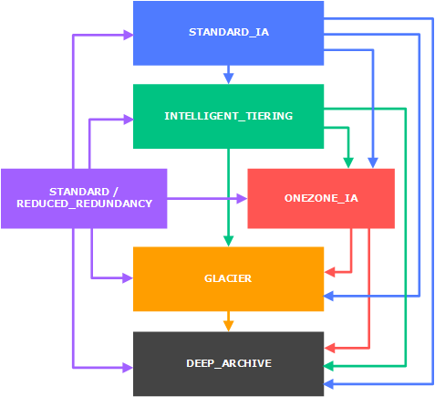
S3 – Moving between storage classes
You can transition objects between storage classes
For infrequently accessed object, move them to STANDARD_IA
For archive objects you don’t need in real-time, GLACIER or DEEP_ARCHIVE
Moving objects can be automated using a lifecycle configuration

Slide 122
Shared Responsibility Model for S3
Infrastructure (global security, durability, availability, sustain concurrent loss of data in two facilities)
Configuration and vulnerability analysis
Compliance validation
S3 Versioning
S3 Bucket Policies
S3 Replication Setup
Logging and Monitoring
S3 Storage Classes
Data encryption at rest and in transit

Slide 123

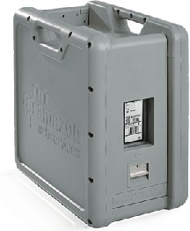
Snowball
Physical data transport solution that helps
moving TBs or PBs of data in or out of AWS
Alternative to moving data over the network (and paying network fees)
Pay per data transfer job
Use cases: large data cloud migrations, DC decommission, disaster recovery
If it takes more than a week to transfer over the network, use Snowball devices!

Slide 124
Snowball Process
Request snowball devices from the AWS console for delivery
Install the snowball client on your servers
Connect the snowball to your servers and copy files using the client
Ship back the device when you’re done (goes to the right AWS facility)
Data will be loaded into an S3 bucket
Snowball is completely wiped

Slide 125







Diagrams
Direct upload to S3:
www: 10Gbit/s
client
Amazon S3 bucket
With snowball
ship
AWS
Snowball
import/ export
Amazon S3 bucket
client
AWS
Snowball

Slide 126


Snowball Edge
AMI
Snowball Edges (100 TB) add computational capability to the device
Supports a custom EC2 AMI so you can perform processing on the go
Supports custom Lambda functions
Very useful to pre-process the data while moving
Use case: data migration, image collation, IoT capture, machine learning
“Snowball” is deprecated in favor of “Snowball Edge”
Lambda function

Slide 127
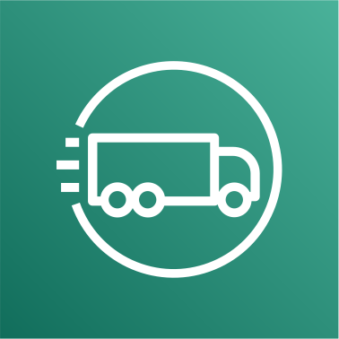
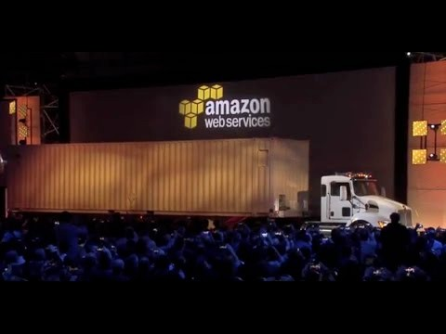
AWS Snowmobile
Transfer exabytes of data (1 EB = 1,000 PB = 1,000,000 TBs)
Each Snowmobile has 100 PB of capacity (use multiple in parallel)
Better than Snowball if you transfer more than 10 PB

Slide 128
Hybrid Cloud for Storage
AWS is pushing for ”hybrid cloud”
Part of your infrastructure is on-premises
Part of your infrastructure is on the cloud
This can be due to
Long cloud migrations
Security requirements
Compliance requirements
IT strategy
S3 is a proprietary storage technology (unlike EFS / NFS), so how do you expose the S3 data on-premise?
AWS Storage Gateway!

Slide 129
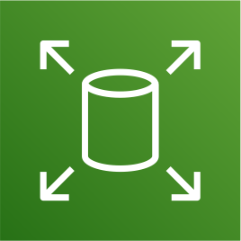




AWS Storage Cloud Native Options
BLOCK
FILE
Amazon EFS
OBJECT
Amazon EBS
EC2 Instance Store
Amazon S3
Glacier

Slide 130




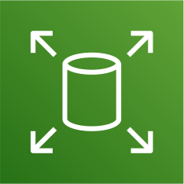


AWS Storage Gateway
Bridge between on-premise data and cloud data in S3
Hybrid storage service to allow on- premises to seamlessly use the AWS Cloud
Use cases: disaster recovery, backup & restore, tiered storage
Files
Tapes
Volumes
AWS Storage Gateway
Types of Storage Gateway:
File Gateway
Volume Gateway
Tape Gateway
No need to know the types at the exam
Amazon EBS
S3
Glacier

Slide 131
Amazon S3 – Summary
Buckets vs Objects: global unique name, tied to a region
S3 security: IAM policy, S3 Bucket Policy (public access), S3 Encryption
S3 Websites: host a static website on Amazon S3
S3 Versioning: multiple versions for files, prevent accidental deletes
S3 Access Logs: log requests made within your S3 bucket
S3 Replication: same-region or cross-region, must enable versioning
S3 Storage Classes: Standard, IA, 1Z-IA, Intelligent, Glacier, Deep Archive
S3 Lifecycle Rules: transition objects between classes
Snowball / Snowmobile: import data onto S3 through a physical device
Storage Gateway: hybrid solution to extend on-premises storage to S3

Slide 132
Databases Section

Slide 133

Databases Intro
Storing data on disk (EFS, EBS, EC2 Instance Store, S3) can have its limits
Sometimes, you want to store data in a database…
You can structure the data
You build indexes to efficiently query / search through the data
You define relationships between your datasets
Databases are optimized for a purpose and come with different features, shapes and constraints

Slide 134
Relational Databases
Looks just like Excel spreadsheets, with links between them!
Can use the SQL language to perform queries / lookups
Students
Subjects
Student ID | Dept ID | Name | Email
1 | M01 | Joe Miller | joe@abc.com
2 | B01 | Sarah T | sarah@abc.com
Student ID | Subject
1 | Physics
1 | Chemistry
1 | Math
2 | History
2 | Geography
2 | Economics
Departments
Dept ID | SPOC | Email | Phone
M01 | Kelly Jones | kelly@abc.com | +1234567890
B01 | Satish Kumar | satish@abc.com | +1234567891

Slide 135
NoSQL Databases
NoSQL = non-SQL = non relational databases
NoSQL databases are purpose built for specific data models and have flexible schemas for building modern applications.
Benefits:
Flexibility: easy to evolve data model
Scalability: designed to scale-out by using distributed clusters
High-performance: optimized for a specific data model
Highly functional: types optimized for the data model
Examples: Key-value, document, graph, in-memory, search databases

Slide 136
NoSQL data example: JSON
JSON = JavaScript Object Notation
JSON is a common form of data that fits into a NoSQL model
Data can be nested
Fields can change over time
Support for new types: arrays, etc…
{
"name": "John", "age": 30,
"cars": [
"Ford",
"BMW",
"Fiat"
],
"address": {
"type": "house",
"number": 23, "street": "Dream Road"
}
}

Slide 137
Databases & Shared Responsibility on AWS
AWS offers use to manage different databases
Benefits include:
Quick Provisioning, High Availability,Vertical and Horizontal Scaling
Automated Backup & Restore, Operations, Upgrades
Operating System Patching is handled by AWS
Monitoring, alerting
Note: many databases technologies could be run on EC2, but you must handle yourself the resiliency, backup, patching, high availability, fault tolerance, scaling…

Slide 138

AWS RDS Overview
RDS stands for Relational Database Service
It’s a managed DB service for DB use SQL as a query language.
It allows you to create databases in the cloud that are managed by AWS
Postgres
MySQL
MariaDB
Oracle
Microsoft SQL Server
Aurora (AWS Proprietary database)

Slide 139
Advantage over using RDS versus deploying DB on EC2
RDS is a managed service:
Automated provisioning, OS patching
Continuous backups and restore to specific timestamp (Point in Time Restore)!
Monitoring dashboards
Read replicas for improved read performance
Multi AZ setup for DR (Disaster Recovery)
Maintenance windows for upgrades
Scaling capability (vertical and horizontal)
Storage backed by EBS (gp2 or io1)
BUT you can’t SSH into your instances

Slide 140

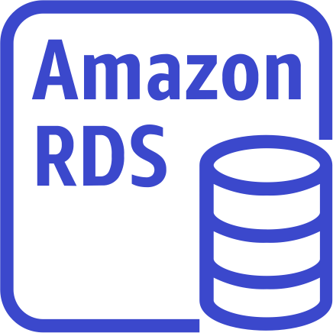



RDS Solution Architecture
Read/write
Elastic Load Balancer
SQL (relational) Database
EC2 Instances
Possibly in an ASG

Slide 141
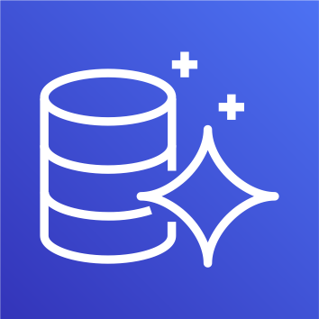

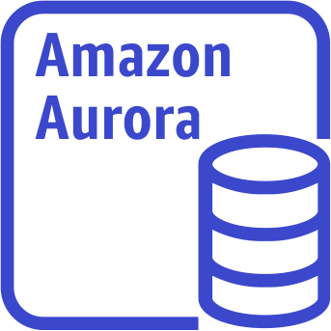
Amazon Aurora
Aurora is a proprietary technology from AWS (not open sourced)
PostgreSQL and MySQL are both supported as Aurora DB
Aurora is “AWS cloud optimized” and claims 5x performance improvement over MySQL on RDS, over 3x the performance of Postgres on RDS
Aurora storage automatically grows in increments of 10GB, up to 64 TB.
Aurora costs more than RDS (20% more) – but is more efficient
Not in the free tier

Slide 142
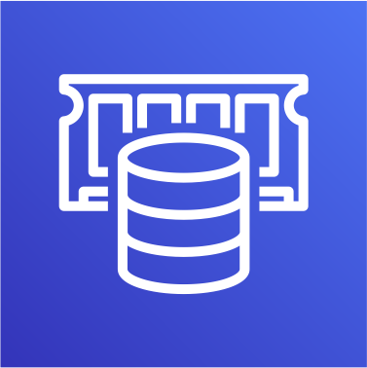
Amazon ElastiCache Overview
The same way RDS is to get managed Relational Databases…
ElastiCache is to get managed Redis or Memcached
Caches are in-memory databases with high performance, low latency
Helps reduce load off databases for read intensive workloads
AWS takes care of OS maintenance / patching, optimizations, setup, configuration, monitoring, failure recovery and backups

Slide 143
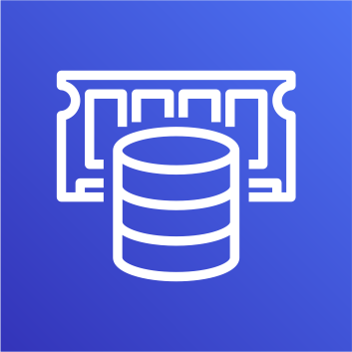


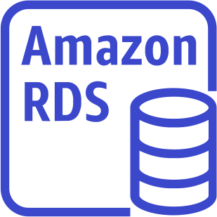
ElastiCache
Solution Architecture - Cache
ElastiCache
In-memory database
Read / write from cache
Fast
EC2 Instances
Possibly in an ASG
Elastic Load Balancer
Read / write From DB Slower
SQL (relational) Database

Slide 144

DynamoDB
Fully Managed Highly available with replication across 3 AZ
NoSQL database - not a relational database
Scales to massive workloads, distributed “serverless” database
Millions of requests per seconds, trillions of row, 100s of TB of storage
Fast and consistent in performance
Single-digit millisecond latency – low latency retrieval
Integrated with IAM for security, authorization and administration
Low cost and auto scaling capabilities

Slide 145
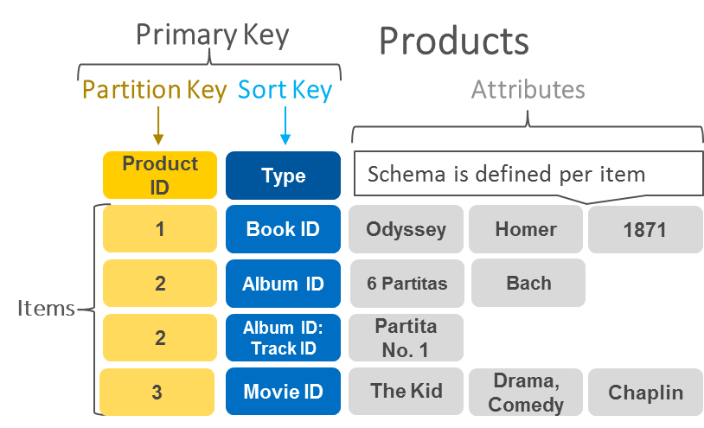
DynamoDB – type of data
DynamoDB is a key/value database
https://aws.amazon.com/nosql/key-value/

Slide 146

Redshift Overview
Redshift is based on PostgreSQL, but it’s not used for OLTP
It’s OLAP – online analytical processing (analytics and data warehousing)
Load data once every hour, not every second
10x better performance than other data warehouses, scale to PBs of data
Columnar storage of data (instead of row based)
Massively Parallel Query Execution (MPP), highly available
Pay as you go based on the instances provisioned
Has a SQL interface for performing the queries
BI tools such as AWS Quicksight or Tableau integrate with it

Slide 147

Amazon EMR
EMR stands for “Elastic MapReduce”
EMR helps creating Hadoop clusters (Big Data) to analyze and process vast amount of data
The clusters can be made of hundreds of EC2 instances
Also supports Apache Spark, HBase, Presto, Flink…
EMR takes care of all the provisioning and configuration
Auto-scaling and integrated with Spot instances
Use cases: data processing, machine learning, web indexing, big data…

Slide 148

Athena Overview
Fully Serverless database with SQL capabilities
Used to query data in S3
Pay per query
Output results back to S3
Secured through IAM
Use Case: one-time SQL queries, serverless queries on S3, log analytics

Slide 149





DMS – Database Migration Service
Quickly and securely migrate databases
to AWS, resilient, self healing
The source database remains available during the migration
Source DB
EC2 instance Running DMS
Supports:
Homogeneous migrations: ex Oracle to Oracle
Heterogeneous migrations: ex Microsoft SQL Server to Aurora
Target DB

Slide 150
Databases Summary in AWS
Relational Databases - OLTP: RDS & Aurora (SQL)
In-memory Database: ElastiCache
Key/Value Database: DynamoDB (serverless)
Warehouse - OLAP: Redshift (SQL)
Hadoop Cluster: EMR
Athena: query data on Amazon S3 (serverless & SQL)
Database Migration: DMS

Slide 151
ECS Section

Slide 152
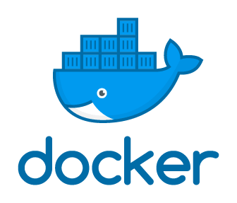
What is Docker?
Docker is a software development platform to deploy apps
Apps are packaged in containers that can be run on any OS
Apps run the same, regardless of where they’re run
Any machine
No compatibility issues
Predictable behavior
Less work
Easier to maintain and deploy
Works with any language, any OS, any technology
Scale containers up and down very quickly (seconds)

Slide 153
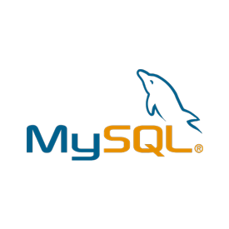

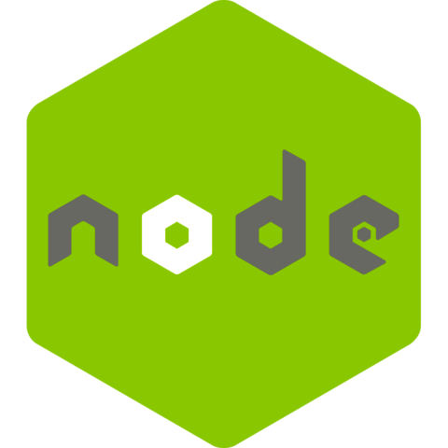
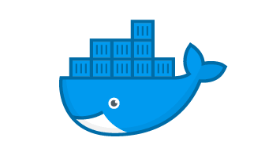
Docker on an OS
Server (ex: EC2 Instance)

Slide 154
Where Docker images are stored?
Docker images are stored in Docker Repositories
Public: Docker Hub https://hub.docker.com/
Find base images for many technologies or OS:
Ubuntu
MySQL
NodeJS, Java…
Private: Amazon ECR (Elastic Container Registry)

Slide 155
Docker versus Virtual Machines
Docker is ”sort of” a virtualization technology, but not exactly
Resources are shared with the host => many containers on one server
Apps
Apps
Apps
Container
Container
Container
Guest OS (VM)
Guest OS (VM)
Guest OS (VM)
Container
Container
Container
Container
Container
Container
Hypervisor
Docker Daemon
Host OS
Host OS (EC2 Instance)
Infrastructure
Infrastructure

Slide 156









ECS
ECS Service
ECS = Elastic Container Service
Launch Docker containers on AWS
You must provision & maintain the infrastructure (the EC2 instances)
AWS takes care of starting / stopping containers
Has integrations with the Application Load Balancer
New Docker Container
EC2 instance
EC2 instance
EC2 instance

Slide 157

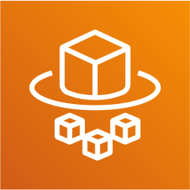







Fargate
Launch Docker containers on AWS
You do not provision the infrastructure (no EC2 instances to manage) – simpler!
Serverless offering
AWS just runs containers for you based on the CPU / RAM you need
New Docker Container
Fargate

Slide 158

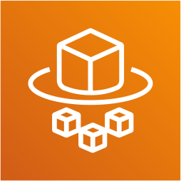





ECR
Elastic Container Registry
Private Docker Registry on AWS
This is where you store your Docker images so they can be run by ECS or Fargate
ECR
Fargate
Image 1
Image 2

Slide 159
ECS Section – Summary
Docker: container technology to run applications
ECS: run Docker containers on EC2 instances
Fargate:
Run Docker containers without provisioning the infrastructure
Serverless offering (no EC2 instances)
ECR: Private Docker Images Repository

Slide 160
Serverless Section

Slide 161
What’s serverless?
Serverless is a new paradigm in which the developers don’t have to manage servers anymore…
They just deploy code
They just deploy… functions !
Initially... Serverless == FaaS (Function as a Service)
Serverless was pioneered by AWS Lambda but now also includes anything that’s managed: “databases, messaging, storage, etc.”
Serverless does not mean there are no servers…
it means you just don’t manage / provision / see them

Slide 162


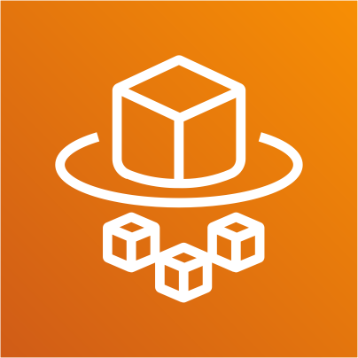

So far in this course…
Amazon S3
DynamoDB
Fargate
Lambda

Slide 163


Why AWS Lambda
Virtual Servers in the Cloud
Limited by RAM and CPU
Continuously running
Scaling means intervention to add / remove servers
Amazon EC2
Virtual functions – no servers to manage!
Limited by time - short executions
Run on-demand
Scaling is automated!
Amazon Lambda

Slide 164
Benefits of AWS Lambda
Easy Pricing:
Pay per request and compute time
Free tier of 1,000,000 AWS Lambda requests and 400,000 GBs of compute time
Integrated with the whole AWS suite of services
Event-Driven: functions get invoked by AWS when needed
Integrated with many programming languages
Easy monitoring through AWS CloudWatch
Easy to get more resources per functions (up to 3GB of RAM!)
Increasing RAM will also improve CPU and network!

Slide 165
AWS Lambda language support
Node.js (JavaScript)
Python
Java (Java 8 compatible)
C# (.NET Core)
Golang
C# / Powershell
Ruby
Custom Runtime API (community supported, example Rust)
Important: Docker is not for AWS Lambda, it’s for ECS / Fargate

Slide 166





Example: Serverless Thumbnail creation
push
New thumbnail in S3
trigger
push
Image name Image size Creation date etc…
New image in S3
AWS Lambda Function Creates a Thumbnail
Metadata in DynamoDB

Slide 167


Example: Serverless CRON Job
Trigger Every 1 hour
CloudWatch Events EventBridge
AWS Lambda Function Perform a task

Slide 168
AWS Lambda Pricing: example
You can find overall pricing information here: https://aws.amazon.com/lambda/pricing/
Pay per calls:
First 1,000,000 requests are free
$0.20 per 1 million requests thereafter ($0.0000002 per request)
Pay per duration: (in increment of 100ms)
400,000 GB-seconds of compute time per month if FREE
• == 400,000 seconds if function is 1GB RAM
• == 3,200,000 seconds if function is 128 MB RAM
After that $1.00 for 600,000 GB-seconds
It is usually very cheap to run AWS Lambda so it’s very popular

Slide 169
Serverless Summary
Lambda is Serverless, Function as a Service, seamless scaling, reactive
Lambda Billing:
By the time run x by the RAM provisioned
By the number of invocations
Language Support: many programming languages except Docker
Invocation time: up to 15 minutes
Use cases:
Create Thumbnails for images uploaded onto S3
Run a Serverless cron job

Slide 170
Deploying and Managing Infrastructure at Scale Section

Slide 171

What is CloudFormation
CloudFormation is a declarative way of outlining your AWS Infrastructure, for any resources (most of them are supported).
For example, within a CloudFormation template, you say:
I want a security group
I want two EC2 instances using this security group
I want an S3 bucket
I want a load balancer (ELB) in front of these machines
Then CloudFormation creates those for you, in the right order, with the
exact configuration that you specify

Slide 172
Benefits of AWS CloudFormation (1/2)
Infrastructure as code
No resources are manually created, which is excellent for control
Changes to the infrastructure are reviewed through code
Cost
Each resources within the stack is tagged with an identifier so you can easily see how much a stack costs you
You can estimate the costs of your resources using the CloudFormation template
Savings strategy: In Dev, you could automation deletion of templates at 5 PM and recreated at 8 AM, safely

Slide 173
Benefits of AWS CloudFormation (2/2)
Productivity
Ability to destroy and re-create an infrastructure on the cloud on the fly
Automated generation of Diagram for your templates!
Declarative programming (no need to figure out ordering and orchestration)
Don’t re-invent the wheel
Leverage existing templates on the web!
Leverage the documentation
Supports (almost) all AWS resources:
Everything we’ll see in this course is supported
You can use “custom resources” for resources that are not supported

Slide 174
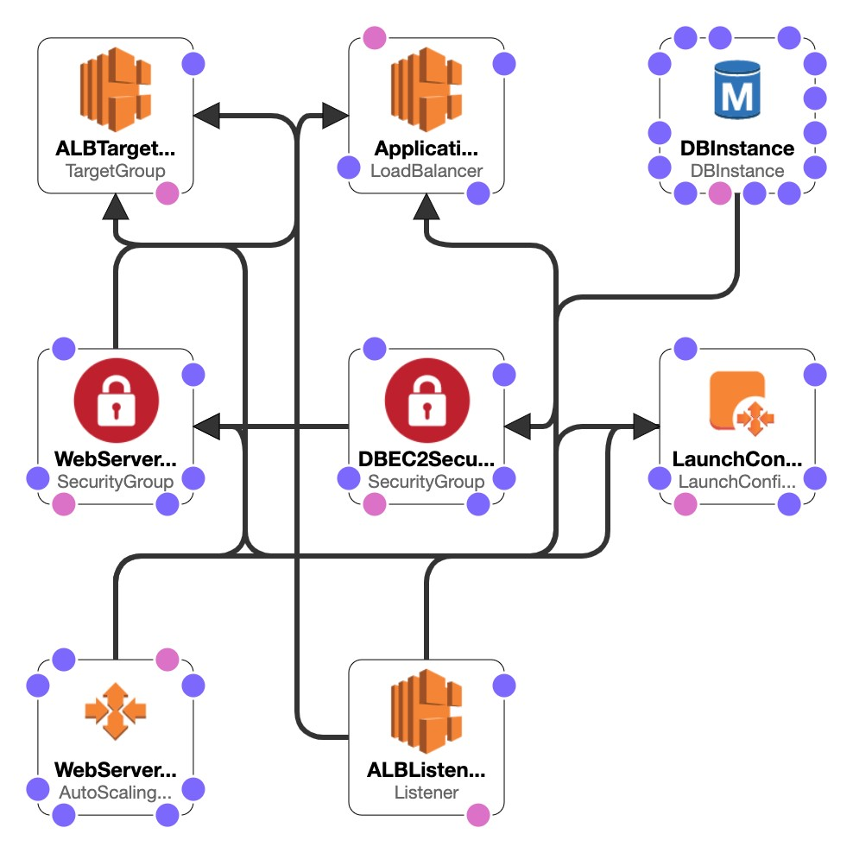
CloudFormation Stack Designer
Example: WordPress CloudFormation Stack
We can see all the resources
We can see the relations
between the components

Slide 175

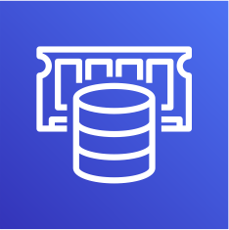






Typical architecture: Web App 3-tier
ElastiCache
Auto Scaling group
Availability zone 1
Multi AZ
Store / retrieve
session data
+ Cached data
Availability zone 2
ELB
Availability zone 3
Amazon RDS Read / write data

Slide 176
Developer problems on AWS
Managing infrastructure
Deploying Code
Configuring all the databases, load balancers, etc
Scaling concerns
Most web apps have the same architecture (ALB + ASG)
All the developers want is for their code to run!
Possibly, consistently across different applications and environments

Slide 177

AWS Elastic Beanstalk Overview
Elastic Beanstalk is a developer centric view of deploying an application on AWS
It uses all the component’s we’ve seen before: EC2, ASG, ELB, RDS, etc…
But it’s all in one view that’s easy to make sense of!
We still have full control over the configuration
Beanstalk = Platform as a Service (PaaS)
Beanstalk is free but you pay for the underlying instances

Slide 178
Elastic Beanstalk
Managed service
Instance configuration / OS is handled by Beanstalk
Deployment strategy is configurable but performed by Elastic Beanstalk
Just the application code is the responsibility of the developer
Three architecture models:
Single Instance deployment: good for dev
LB + ASG: great for production or pre-production web applications
ASG only: great for non-web apps in production (workers, etc..)

Slide 179
Elastic Beanstalk
Support for many platforms:
Go
Java SE
Java with Tomcat
.NET on Windows Server with IIS
Node.js
PHP
Python
Ruby
Packer Builder
Single Container Docker
Multi-Container Docker
Preconfigured Docker
If not supported, you can write your custom platform (advanced)

Slide 180



AWS CodeDeploy
We want to deploy our application
automatically
EC2 Instances being upgraded
v1
v2
Works with EC2 Instances
Works with On-Premises Servers
Hybrid service
v1
v2
v1
v2
Servers / Instances must be provisioned and configured ahead of time with the CodeDeploy Agent
On-premises Servers being upgraded

Slide 181

AWS Systems Manager (SSM)
Helps you manage your EC2 and On-Premises systems at scale
Another Hybrid AWS service
Get operational insights about the state of your infrastructure
Suite of 10+ products
Most important features are:
Patching automation for enhanced compliance
Run commands across an entire fleet of servers
Store parameter configuration with the SSM Parameter Store
Works for both Windows and Linux OS

Slide 182
How Systems Manager works
We need to install the SSM agent onto the systems we control
Installed by default on Amazon
Linux AMI & some Ubuntu AMI
If an instance can’t be controlled with SSM, it’s
probably an issue with the SSM agent!
Thanks to the SSM agent, we
can run commands, patch &
configure our servers
SSM
SSM Agent
SSM Agent
SSM Agent
EC2 Instance
EC2 Instance
On Premise VM

Slide 183



AWS OpsWorks
Chef & Puppet help you perform server configuration automatically, or repetitive actions
They work great with EC2 & On-Premises VM
AWS OpsWorks = Managed Chef & Puppet
It’s an alternative to AWS SSM
Only provision standard AWS resources:
EC2 Instances, Databases, Load Balancers, EBS volumes…
In the exam: Chef or Puppet needed => AWS OpsWorks

Slide 184







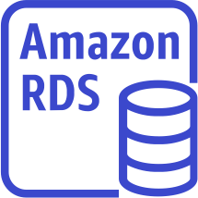

OpsWorks Architecture
Cookbook Repository
OpsWorks Stack
App Repository
Elastic Load Balancer Layer
ALB
OpsWorks Layers
Application Server Layer
App Server Instances (EC2)
OpsWorks Layers
Applications
Database Layer
Database Server (RDS)
OpsWorks Layers

Slide 185
Deployment - Summary
CloudFormation: (AWS only)
Infrastructure as Code, works with almost all of AWS resources
Repeat across Regions & Accounts
Beanstalk: (AWS only)
Platform as a Service (PaaS), limited to certain programming languages or Docker
Deploy code consistently with a known architecture: ex, ALB + EC2 + RDS
CodeDeploy (hybrid): deploy & upgrade any application onto servers
Systems Manager (hybrid): patch, configure and run commands at scale
OpsWorks (hybrid): managed Chef and Puppet in AWS

Slide 186
Global Infrastructure Section

Slide 187



Why make a global application?
A global application is an application deployed in multiple geographies
On AWS: this could be Regions and / or Edge Locations
Decreased Latency
Latency is the time it takes for a network packet to reach a server
It takes time for a packet from Asia to reach the US
Deploy your applications closer to your users to decrease latency, better experience
Disaster Recovery (DR)
If an AWS region goes down (earthquake, storms, power shutdown, politics)…
You can fail-over to another region and have your application still working
A DR plan is important to increase the availability of your application
Attack protection: distributed global infrastructure is harder to attack

Slide 188
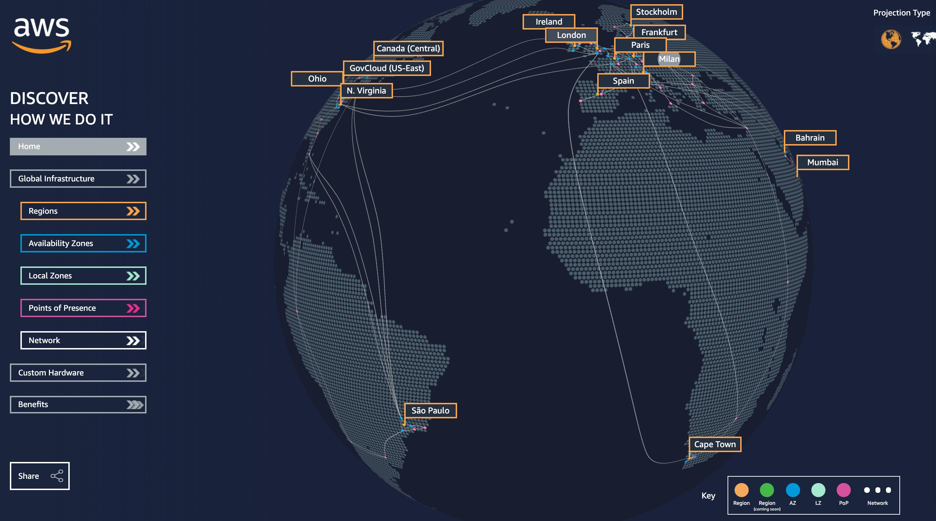
Global AWS Infrastructure
Regions: For deploying applications and infrastructure
Availability Zones: Made of multiple data centers
Edge Locations (Points of Presence): for content delivery as close as possible to users
More at: https://infrastructure.aw s/

Slide 189




Global Applications in AWS
Global DNS: Route 53
Great to route users to the closest deployment with least latency
Great for disaster recovery strategies
Global Content Delivery Network (CDN): CloudFront
Replicate part of your application to AWS Edge Locations – decrease latency
Cache common requests – improved user experience and decreased latency
S3 Transfer Acceleration
Accelerate global uploads & downloads into Amazon S3
AWS Global Accelerator:
Improve global application availability and performance using the AWS global network

Slide 190

Amazon Route 53 Overview
Route53 is a Managed DNS (Domain Name System)
DNS is a collection of rules and records which helps clients understand how to reach a server through URLs.
In AWS, the most common records are:
www.google.com => 12.34.56.78 == A record (IPv4)
www.google.com => 2001:0db8:85a3:0000:0000:8a2e:0370:7334 == AAAA IPv6
search.google.com => www.google.com == CNAME: hostname to hostname
example.com => AWS resource == Alias (ex: ELB, CloudFront, S3, RDS, etc…)

Slide 191



Route 53 – Diagram for A Record
DNS Request
myapp.mydomain.com
Send back IP: 32.45.67.85
(A record: hostname to IP)
Route 53
HTTP Request IP:32.45.67.85
Host: myapp.mydomain.com
Web browser
HTTP Response
Application Server IP: 32.45.67.85

Slide 192






Route 53 Routing Policies
Need to know them at a high-level for the Cloud Practitioner Exam
SIMPLE ROUTING POLICY WEIGHTED ROUTING POLICY
No health checks
Weight 70
foo.example.com
70%
A: 11.22.33.44
Weight 20
20%
Web browser
Route 53
Route 53
10%
Weight 10

Slide 193
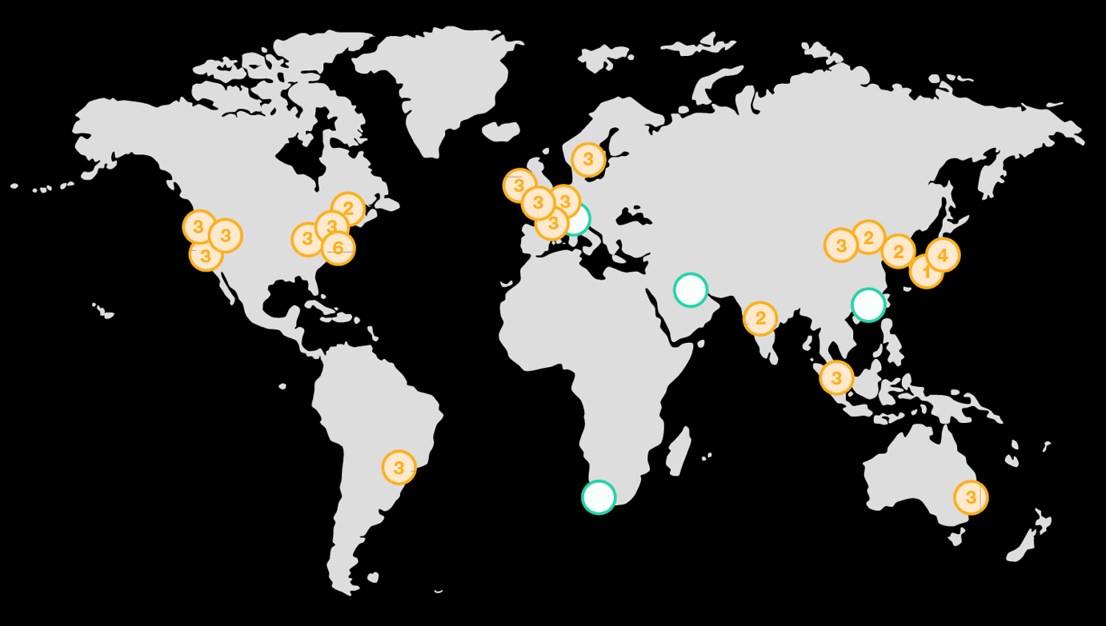












Route 53 Routing Policies
LATENCY ROUTING POLICY
FAILOVER ROUTING POLICY
Disaster Recovery
Health check On primary
Primary
Route 53
Failover

Slide 194

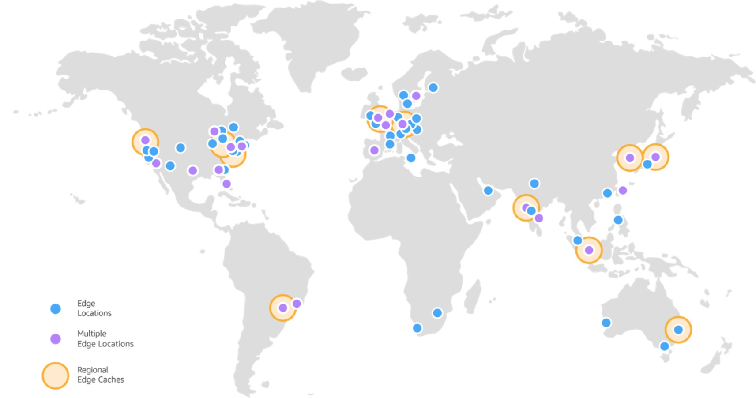



AWS CloudFront
Content Delivery Network (CDN)
Improves read performance, content is cached at the edge
Improves users experience
216 Point of Presence globally (edge locations)
DDoS protection (because worldwide), integration with Shield, AWS Web Application Firewall
Source: https://aws.amazon.com/cloudfront/features/?nc=sn&loc=2

Slide 195
CloudFront – Origins
S3 bucket
For distributing files and caching them at the edge
Enhanced security with CloudFront Origin Access Identity (OAI)
CloudFront can be used as an ingress (to upload files to S3)
Custom Origin (HTTP)
Application Load Balancer
EC2 instance
S3 website (must first enable the bucket as a static S3 website)
Any HTTP backend you want

Slide 196





CloudFront at a high level
GET /beach.jpg?size=300x300 HTTP/1.1
User-Agent: Mozilla/4.0 (compatible; MSIE5.01; Windows NT) Host: www.example.com
Accept-Encoding: gzip, deflate
Origin
S3
or
HTTP
Forward Request to your Origin
Client
CloudFront Edge Location
Local Cache

Slide 197
















CloudFront – S3 as an Origin
AWS Cloud
Public www
Private AWS
Edge
Los Angeles
Private AWS
Edge Mumbai
Private AWS
Private AWS
Origin (S3 bucket)
OAI
Public www
Edge
São Paulo
Edge
Melbourne
Origin Access Identity
+ S3 bucket policy

Slide 198
CloudFront vs S3 Cross Region Replication
CloudFront:
Global Edge network
Files are cached for a TTL (maybe a day)
Great for static content that must be available everywhere
S3 Cross Region Replication:
Must be setup for each region you want replication to happen
Files are updated in near real-time
Read only
Great for dynamic content that needs to be available at low-latency in few regions

Slide 199



S3 Transfer Acceleration
Increase transfer speed by transferring file to an AWS edge location which will forward the data to the S3 bucket in the target region
Fast
(public www)
Fast
(private AWS)
File in USA
Edge Location
USA
S3 Bucket
Australia
Test the tool at: https://s3-accelerate-speedtest.s3-accelerate.amazonaws.com/en/accelerate-speed-comparsion.html

Slide 200









AWS Global Accelerator
Improve global application availability and performance using the AWS global network
Leverage the AWS internal network to optimize the route to your application (60% improvement)
2 Anycast IP are created for your application and traffic is sent through Edge Locations
The Edge locations send the traffic to your application
America
Europe
Edge location
Private AWS
India
Public ALB
Australia

Slide 201
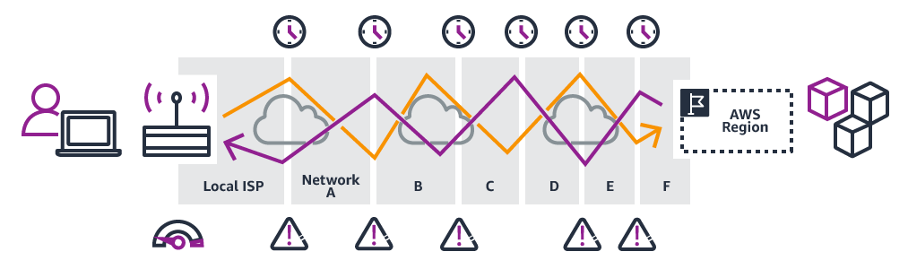
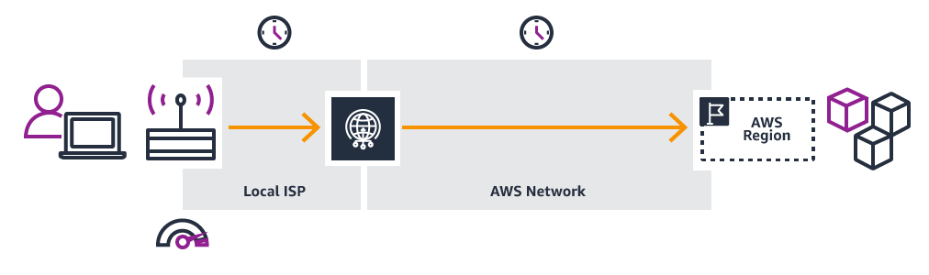
AWS Global Accelerator
Without Global Accelerator
With Global Accelerator
https://aws.amazon.com/global-accelerator

Slide 202
AWS Global Accelerator vs CloudFront
They both use the AWS global network and its edge locations around the world
Both services integrate with AWS Shield for DDoS protection.
CloudFront – Content Delivery Network
Improves performance for your cacheable content (such as images and videos)
Content is served at the edge
Global Accelerator
No caching, proxying packets at the edge to applications running in one or more AWS Regions.
Improves performance for a wide range of applications over TCP or UDP
Good for HTTP use cases that require static IP addresses
Good for HTTP use cases that required deterministic, fast regional failover

Slide 203
Global Applications in AWS - Summary
Global DNS: Route 53
Great to route users to the closest deployment with least latency
Great for disaster recovery strategies
Global Content Delivery Network (CDN): CloudFront
Replicate part of your application to AWS Edge Locations – decrease latency
Cache common requests – improved user experience and decreased latency
S3 Transfer Acceleration
Accelerate global uploads & downloads into Amazon S3
AWS Global Accelerator:
Improve global application availability and performance using the AWS global network

Slide 204
Cloud Integration Section

Slide 205
Section Introduction
When we start deploying multiple applications, they will inevitably need to communicate with one another
There are two patterns of application communication
1) Synchronous communications (application to application)
2) Asynchronous / Event based (application to queue to application)
Buying Service
Shipping Service
Buying Service
Queue
Shipping Service

Slide 206
Section Introduction
Synchronous between applications can be problematic if there are sudden spikes of traffic
What if you need to suddenly encode 1000 videos but usually it’s 10?
In that case, it’s better to decouple your applications:
using SQS: queue model
using SNS: pub/sub model
using Kinesis: real-time data streaming model (out of scope for the exam)
These services can scale independently from our application!

Slide 207


Amazon SQS – Simple Queue Service What’s a queue?
Consumer
Producer
Consumer
Producer
Send messages
Poll messages
Consumer
Producer
SQS Queue
Consumer

Slide 208

Amazon SQS – Standard Queue
Oldest AWS offering (over 10 years old)
Fully managed service (~serverless), use to decouple applications
Scales from 1 message per second to 10,000s per second
Default retention of messages: 4 days, maximum of 14 days
No limit to how many messages can be in the queue
Messages are deleted after they’re read by consumers
Low latency (<10 ms on publish and receive)
Consumers share the work to read messages & scale horizontally

Slide 209





SQS to decouple between application tiers
WEB SERVERS VIDEO PROCESSING
EC2 Instances
EC2 Instances
requests
PUT
SQS Queue
scaling
Auto Scaling Group
Auto Scaling Group

Slide 210



Amazon SNS
What if you want to send one message to many receivers?
Direct Pub / Sub
integration
Email notification
Email notification
Fraud Service
Fraud Service
Buying Service
Buying Service
Shipping Service
Shipping Service
SNS Topic
SQS Queue
SQS Queue

Slide 211

Amazon SNS
The “event publishers” only sends message to one SNS topic
As many “event subscribers” as we want to listen to the SNS topic notifications
Each subscriber to the topic will get all the messages
Up to 10,000,000 subscriptions per topic, 100,000 topics limit
SNS Subscribers can be:
HTTP / HTTPS (with delivery retries – how many times)
Emails, SMS messages, Mobile Notifications
SQS queues (fan-out pattern), Lambda Functions (write-your-own integration)

Slide 212
Integration Section – Summary
SQS:
Queue service in AWS
Multiple Producers, messages are kept up to 14 days
Multiple Consumers share the read and delete messages when done
Used to decouple applications in AWS
SNS:
Notification service in AWS
Subscribers: Email, Lambda, SQS, HTTP, Mobile…
Multiple Subscribers, send all messages to all of them
No message retention

Slide 213
Cloud Monitoring Section

Slide 214

Amazon CloudWatch Metrics
CloudWatch provides metrics for every services in AWS
Metric is a variable to monitor (CPUUtilization, NetworkIn…)
Metrics have timestamps
Can create CloudWatch dashboards of metrics

Slide 215
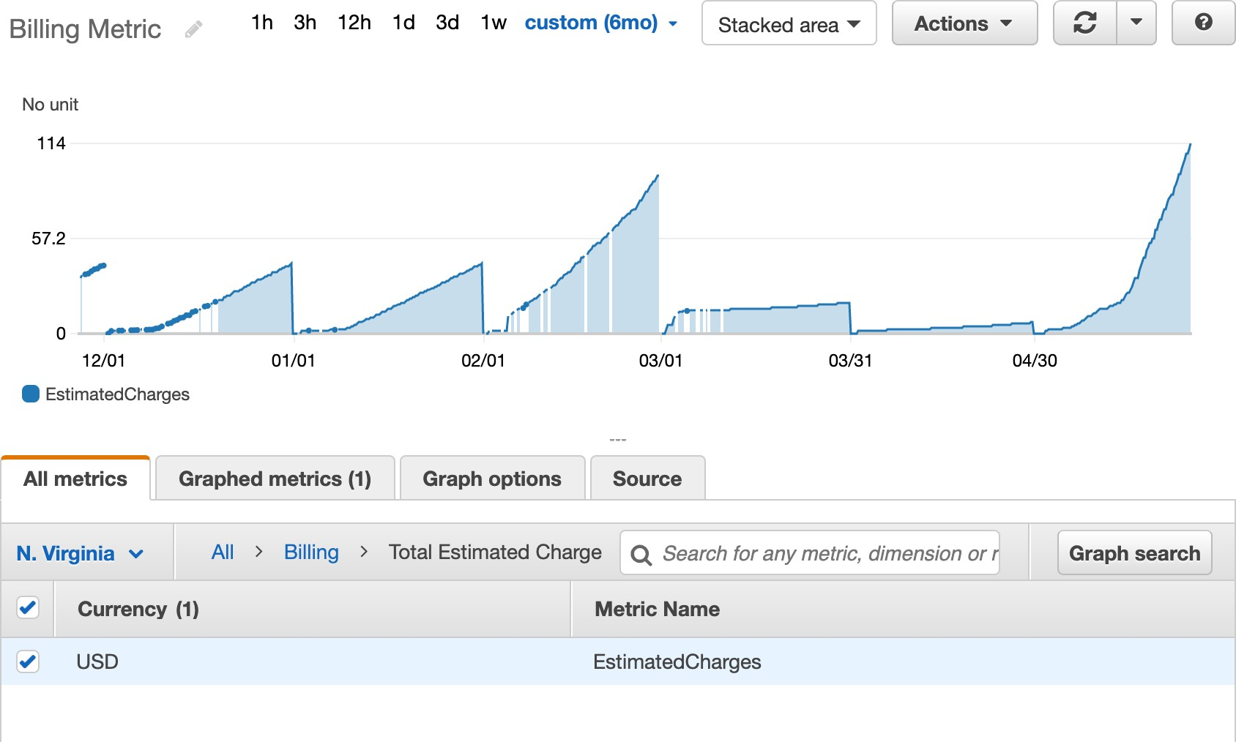
Example: CloudWatch Billing metric (us-east-1)

Slide 216
Important Metrics
EC2 instances: CPU Utilization, Status Checks, Network (not RAM)
Default metrics every 5 minutes
Option for Detailed Monitoring ($$$): metrics every 1 minute
EBS volumes: Disk Read/Writes
S3 buckets: BucketSizeBytes, NumberOfObjects, AllRequests
Billing: Total Estimated Charge (only in us-east-1)
Service Limits: how much you’ve been using a service API
Custom metrics: push your own metrics

Slide 217

Amazon CloudWatch Alarms
Alarms are used to trigger notifications for any metric
Alarms actions…
Auto Scaling: increase or decrease EC2 instances “desired” count
EC2 Actions: stop, terminate, reboot or recover an EC2 instance
SNS notifications: send a notification into an SNS topic
Various options (sampling, %, max, min, etc…)
Can choose the period on which to evaluate an alarm
Example: create a billing alarm on the CloudWatch Billing metric
Alarm States: OK. INSUFFICIENT_DATA, ALARM

Slide 218

Amazon CloudWatch Logs
CloudWatch Logs can collect log from:
Elastic Beanstalk: collection of logs from application
ECS: collection from containers
AWS Lambda: collection from function logs
CloudTrail based on filter
CloudWatch log agents: on EC2 machines or on-premises servers
Route53: Log DNS queries
Enables real-time monitoring of logs
Adjustable CloudWatch Logs retention

Slide 219
CloudWatch Logs for EC2
By default, no logs from your EC2 instance will go to CloudWatch
You need to run a CloudWatch agent on EC2 to push the log files you want
Make sure IAM permissions are correct
The CloudWatch log agent can be setup on-premises too
CloudWatch Logs
CloudWatch Logs Agent
CloudWatch Logs Agent
On Premise Server
EC2 Instance

Slide 220





Amazon CloudWatch Events
Schedule: Cron jobs (scheduled scripts)
Schedule Every hour
Trigger script on Lambda function
Event Pattern: Event rules to react to a service doing something
IAM Root User Sign in Event
SNS Topic with Email Notification
Trigger Lambda functions, send SQS/SNS messages…

Slide 221

Amazon EventBridge
EventBridge is the next evolution of CloudWatch Events
Default event bus: generated by AWS services (CloudWatch Events)
Partner event bus: receive events from SaaS service or applications (Zendesk, DataDog, Segment, Auth0…)
Custom Event buses: for your own applications
Schema Registry: model event schema
EventBridge has a different name to mark the new capabilities
The CloudWatch Events name will be replaced with EventBridge

Slide 222

AWS CloudTrail
Provides governance, compliance and audit for your AWS Account
CloudTrail is enabled by default!
Get an history of events / API calls made within your AWS Account by:
Console
SDK
CLI
AWS Services
Can put logs from CloudTrail into CloudWatch Logs or S3
A trail can be applied to All Regions (default) or a single Region.
If a resource is deleted in AWS, investigate CloudTrail first!

Slide 223








CloudTrail Diagram
SDK
CloudTrail Console
CloudWatch Logs
CLI
Console
Inspect & Audit
S3 Bucket
IAM Users & IAM Roles

Slide 224

AWS X-Ray
Debugging in Production, the good old way:
Test locally
Add log statements everywhere
Re-deploy in production
Log formats differ across applications and log analysis is hard.
Debugging: one big monolith “easy”, distributed services “hard”
No common views of your entire architecture
Enter… AWS X-Ray!

Slide 225
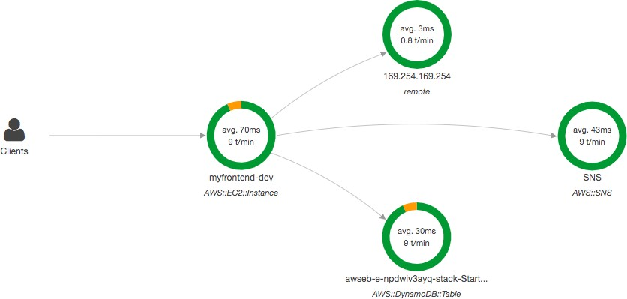
AWS X-Ray
Visual analysis of our applications

Slide 226
AWS X-Ray advantages
Troubleshooting performance (bottlenecks)
Understand dependencies in a microservice architecture
Pinpoint service issues
Review request behavior
Find errors and exceptions
Are we meeting time SLA?
Where I am throttled?
Identify users that are impacted

Slide 227

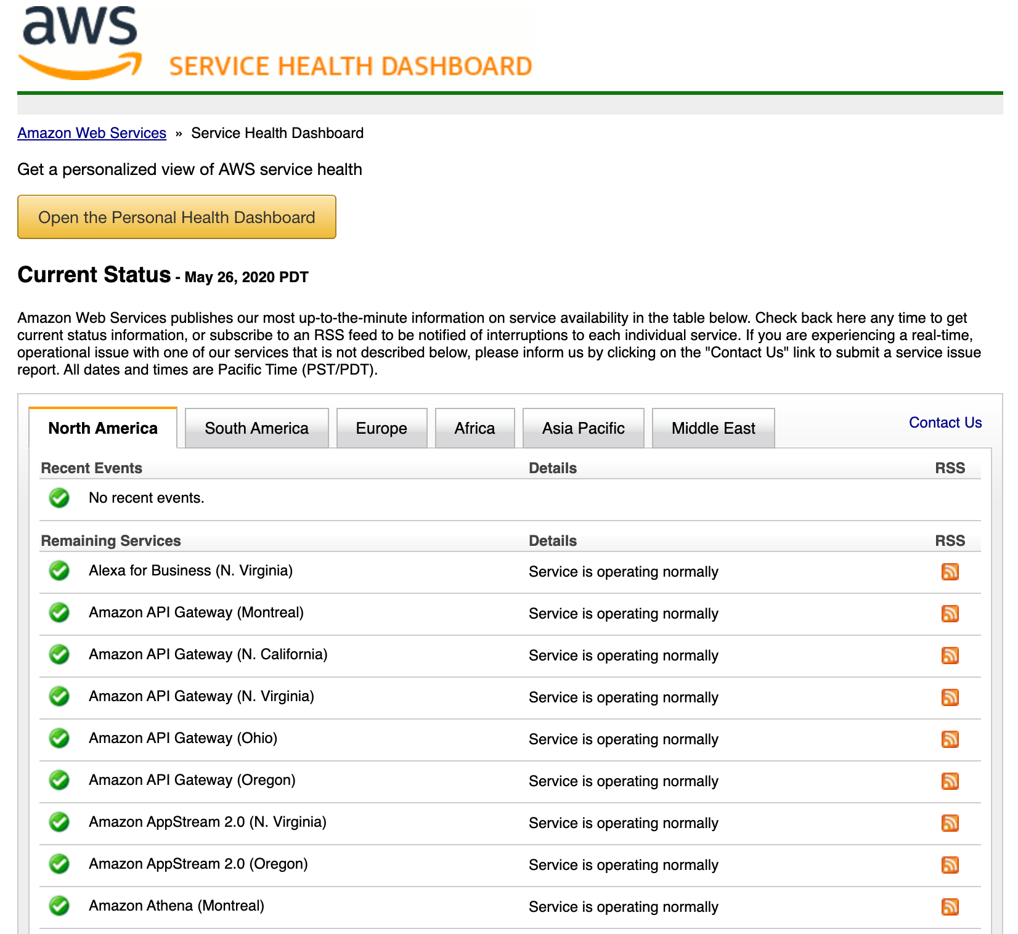
AWS Status - Service Health Dashboard
Shows all regions, all services health
Shows historical information for each day
Has an RSS feed you can subscribe to
https://status.aws.amazon.com/

Slide 228

AWS Personal Health Dashboard
AWS Personal Health Dashboard provides alerts and remediation guidance when AWS is experiencing events that may impact you.
While the Service Health Dashboard displays the general status of AWS services, Personal Health Dashboard gives you a personalized view into the performance and availability of the AWS services underlying your AWS resources.
The dashboard displays relevant and timely information to help you manage events in progress and provides proactive notification to help you plan for scheduled activities.

Slide 229


AWS Personal Health Dashboard
Global service https://phd.aws.amazon.com/
Shows how AWS outages directly impact you & your AWS resources
Alert, remediation, proactive, scheduled activities

Slide 230
Monitoring Summary
CloudWatch:
Metrics: monitor the performance of AWS services and billing metrics
Alarms: automate notification, perform EC2 action, notify to SNS based on metric
Logs: collect log files from EC2 instances, servers, Lambda functions…
Events (or EventBridge): react to events in AWS, or trigger a rule on a schedule
CloudTrail: audit API calls made within your AWS account
X-Ray: trace requests made through your distributed applications
Service Health Dashboard: status of all AWS services across all regions
Personal Health Dashboard: AWS events that impact your infrastructure

Slide 231
VPC Section

Slide 232
VPC – Crash Course
VPC is something you should know in depth for the AWS Certified Solutions Architect Associate & AWS Certified SysOps Administrator
At the AWS Certified Cloud Practitioner Level, you should know about:
VPC, Subnets, Internet Gateways & NAT Gateways
Security Groups, Network ACL (NACL),VPC Flow Logs
VPC Peering,VPC Endpoints
Site to Site VPN & Direct Connect
Transit Gateway
I will just give you an overview, less than 1 or 2 questions at your exam.
We’ll have a look at the “default VPC” (created by default by AWS for you)
There is a summary lecture at the end. It’s okay if you don’t understand it all

Slide 233





VPC & Subnets Primer
www
VPC - Virtual Private Cloud: private
network to deploy your resources (regional resource)
Subnets allow you to partition your
network inside your VPC (Availability Zone resource)
A public subnet is a subnet that is accessible from the internet
A private subnet is a subnet that is not accessible from the internet
To define access to the internet and between subnets, we use Route Tables.
Public Subnet
Private Subnet
AZ A

Slide 234







VPC Diagram
AWS Cloud
 | Availability Zone 1 | Region | Availability Zone 2
 | VPC Public subnet Private subnet | VPC CIDR Range: 10.0.0.0/16 | Public subnet Private subnet

Slide 235



Internet Gateway & NAT Gateways
www
Internet Gateways helps our VPC instances connect with the internet
Public Subnets have a route to the internet gateway.
IGW
NAT
Public Subnet
Private Subnet AZ A
NAT Gateways (AWS-managed) & NAT Instances (self-managed) allow your instances in your Private Subnets to access the internet while remaining private

Slide 236




Network ACL & Security Groups
NACL (Network ACL)
A firewall which controls traffic from and to subnet
Can have ALLOW and DENY rules
Are attached at the Subnet level
Rules only include IP addresses
VPC
Public subnet
NACL
Security Groups
A firewall that controls traffic to and from an ENI / an EC2 Instance
Can have only ALLOW rules
Rules include IP addresses and other security groups
Security group

Slide 237

Network ACLs vs Security Groups
https://docs.aws.amazon.com/vpc/latest/userguide/VPC_Secur ity.html#VPC_Security_Comparison

Slide 238

VPC Flow Logs
Capture information about IP traffic going into your interfaces:
VPC Flow Logs
Subnet Flow Logs
Elastic Network Interface Flow Logs
Helps to monitor & troubleshoot connectivity issues. Example:
Subnets to internet
Subnets to subnets
Internet to subnets
Captures network information from AWS managed interfaces too: Elastic Load Balancers, ElastiCache, RDS, Aurora, etc…
VPC Flow logs data can go to S3 / CloudWatch Logs

Slide 239






VPC Peering
Connect two VPC, privately using AWS’ network
Make them behave as if they were in the same network
Must not have overlapping CIDR (IP address range)
VPC Peering connection is not transitive (must be established for each VPC that need to communicate with one another)
VPC peering A ➔B
VPC A
VPC B
VPC C
VPC peering A ➔C
VPC peering B ➔C

Slide 240








VPC Endpoints
Endpoints allow you to connect to AWS Services using a private network instead of the public www network
This gives you enhanced security and lower latency to access AWS services
VPC
Private subnet
VPC Endpoint Interface (ENI)
VPC Endpoint Gateway: S3 & DynamoDB
VPC Endpoint Interface: the rest
VPC Endpoint Gateway
S3
DynamoDB
CloudWatch

Slide 241




Site to Site VPN & Direct Connect
Site to Site VPN
Connect an on-premises VPN to AWS
The connection is automatically encrypted
Goes over the public internet
Direct Connect (DX)
Establish a physical connection between on-premises and AWS
The connection is private, secure and fast
Goes over a private network
Takes at least a month to establish
Public www
Public www
Site-to-Site VPN (encrypted)
On-premises DC
VPC
Private
Private
Direct Connect

Slide 242








Site-to-Site VPN
On-premises: must use a Customer Gateway (CGW)
AWS: must use a Virtual Private Gateway (VGW)
Corporate data center
Site-to-Site VPN
VPC
Private subnet
10.3.0.0/20
Customer Gateway
Virtual Private Gateway
10.0.0.1/24

Slide 243

Network topologies can become complicated

Slide 244


Transit Gateway
For having transitive peering between thousands of VPC and on-premises, hub-and-spoke (star) connection
One single Gateway to provide this functionality
Works with Direct Connect Gateway,VPN connections

Slide 245
VPC Closing Comments
VPC: Virtual Private Cloud
Subnets: Tied to an AZ, network partition of the VPC
Internet Gateway: at the VPC level, provide Internet Access
NAT Gateway / Instances: give internet access to private subnets
NACL: Stateless, subnet rules for inbound and outbound
Security Groups: Stateful, operate at the EC2 instance level or ENI
VPC Peering: Connect two VPC with non overlapping IP ranges, nontransitive
VPC Endpoints: Provide private access to AWS Services within VPC
VPC Flow Logs: network traffic logs
Site to Site VPN: VPN over public internet between on-premises DC and AWS
Direct Connect: direct private connection to AWS
Transit Gateway: Connect thousands of VPC and on-premises networks together

Slide 246
Security & Compliance Section

Slide 247
AWS Shared Responsibility Model
AWS responsibility - Security of the Cloud
Protecting infrastructure (hardware, software, facilities, and networking) that runs all the AWS services
Managed services like S3, DynamoDB, RDS, etc.
Customer responsibility - Security in the Cloud
For EC2 instance, customer is responsible for management of the guest OS (including security patches and updates), firewall & network configuration, IAM
Encrypting application data
Shared controls:
Patch Management, Configuration Management, Awareness & Training

Slide 248

Example, for RDS
AWS responsibility:
Manage the underlying EC2 instance, disable SSH access
Automated DB patching
Automated OS patching
Audit the underlying instance and disks & guarantee it functions
Your responsibility:
Check the ports / IP / security group inbound rules in DB’s SG
In-database user creation and permissions
Creating a database with or without public access
Ensure parameter groups or DB is configured to only allow SSL connections
Database encryption setting

Slide 249

Example, for S3
AWS responsibility:
Guarantee you get unlimited storage
Guarantee you get encryption
Ensure separation of the data between different customers
Ensure AWS employees can’t access your data
Your responsibility:
Bucket configuration
Bucket policy / public setting
IAM user and roles
Enabling encryption

Slide 250
Shared Responsibility Model diagram
https://aws.amazon.com/compliance/shared-responsibility-model/

Slide 251



















What’s a DDOS* Attack?
*Distributed Denial-of-Service
normal users
Not accessible Not responsive
attacker
application server
masters
bots

Slide 252
DDOS Protection on AWS
AWS Shield Standard: protects against DDOS attack for your website and applications, for all customers at no additional costs
AWS Shield Advanced: 24/7 premium DDoS protection
AWS WAF: Filter specific requests based on rules
CloudFront and Route 53:
Availability protection using global edge network
Combined with AWS Shield, provides attack mitigation at the edge
Be ready to scale – leverage AWS Auto Scaling

Slide 253

Sample Reference Architecture for DDoS Protection
https://aws.amazon.com/answers/networking/aws-ddos-attack-mitigation/

Slide 254

AWS Shield
AWS Shield Standard:
Free service that is activated for every AWS customer
Provides protection from attacks such as SYN/UDP Floods, Reflection attacks and other layer 3/layer 4 attacks
AWS Shield Advanced:
Optional DDoS mitigation service ($3,000 per month per organization)
Protect against more sophisticated attack on Amazon EC2, Elastic Load Balancing (ELB), Amazon CloudFront, AWS Global Accelerator, and Route 53
24/7 access to AWS DDoS response team (DRP)
Protect against higher fees during usage spikes due to DDoS

Slide 255

AWS WAF – Web Application Firewall
Protects your web applications from common web exploits (Layer 7)
Layer 7 is HTTP (vs Layer 4 is TCP)
Deploy on Application Load Balancer, API Gateway, CloudFront
Define Web ACL (Web Access Control List):
Rules can include IP addresses, HTTP headers, HTTP body, or URI strings
Protects from common attack - SQL injection and Cross-Site Scripting (XSS)
Size constraints, geo-match (block countries)
Rate-based rules (to count occurrences of events) – for DDoS protection

Slide 256

Penetration Testing on AWS Cloud
AWS customers are welcome to carry out security assessments or penetration tests against their AWS infrastructure without prior approval for 8 services:
Amazon EC2 instances, NAT Gateways, and Elastic Load Balancers
Amazon RDS
Amazon CloudFront
Amazon Aurora
Amazon API Gateways
AWS Lambda and Lambda Edge functions
Amazon Lightsail resources
Amazon Elastic Beanstalk environments
List can increase over time (you won’t be tested on that at the exam)

Slide 257
Penetration Testing on your AWS Cloud
Prohibited Activities
DNS zone walking via Amazon Route 53 Hosted Zones
Denial of Service (DoS), Distributed Denial of Service (DDoS), Simulated DoS, Simulated DDoS
Port flooding
Protocol flooding
Request flooding (login request flooding, API request flooding)
For any other simulated events, contact aws-security-simulated- event@amazon.com
Read more: https://aws.amazon.com/security/penetration-testing/

Slide 258

AWS KMS (Key Management Service)
Anytime you hear “encryption” for an AWS service, it’s most likely KMS
KMS = AWS manages the encryption keys for us
Encryption Opt-in:
EBS volumes: encrypt volumes
S3 buckets: Server-side encryption of objects
Redshift database: encryption of data
RDS database: encryption of data
EFS drives: encryption of data
Encryption Automatically enabled:
CloudTrail Logs
S3 Glacier
Storage Gateway

Slide 259


CloudHSM
KMS => AWS manages the software for encryption
CloudHSM => AWS provisions encryption hardware
Dedicated Hardware (HSM = Hardware Security Module)
You manage your own encryption keys entirely (not AWS)
HSM device is tamper resistant, FIPS 140-2 Level 3 compliance
Sample HSM device

Slide 260



CloudHSM Diagram
AWS manages the Hardware
SSL Connection
User manages the Keys
CloudHSM Client
AWS CloudHSM

Slide 261
Types of KMS Keys
Customer Manager CMK:
Create, manage and use, can enable or disable
Possibility of rotation policy (new key generated every year, old key preserved)
Possibility to bring-your-own-key
AWS managed CMK:
Used by AWS service (aws/s3, aws/ebs, aws/redshift)
Managed by AWS
CloudHSM Keys (custom keystore):
Keys generated from your own CloudHSM hardware device
Cryptographic operations are performed within the CloudHSM cluster

Slide 262

AWS Secrets Manager
Newer service, meant for storing secrets
Capability to force rotation of secrets every X days
Automate generation of secrets on rotation (uses Lambda)
Integration with Amazon RDS (MySQL, PostgreSQL, Aurora)
Secrets are encrypted using KMS
Mostly meant for RDS integration

Slide 263

AWS Artifact (not really a service)
Portal that provides customers with on-demand access to AWS compliance documentation and AWS agreements
Artifact Reports - Allows you to download AWS security and compliance documents, like AWS ISO certifications, Payment Card Industry (PCI), and System and Organization Control (SOC) reports
Artifact Agreements - Allows you to review, accept, and track the status of AWS agreements such as the Business Associate Addendum (BAA)
Can be used to support internal audit or compliance

Slide 264

Amazon GuardDuty
Intelligent Threat discovery to Protect AWS Account
Uses Machine Learning algorithms, anomaly detection, 3rd party data
One click to enable (30 days trial), no need to install software
Input data includes:
CloudTrail Logs: unusual API calls, unauthorized deployments
VPC Flow Logs: unusual internal traffic, unusual IP address
DNS Logs: compromised EC2 instances sending encoded data within DNS queries
Can setup CloudWatch Event rules to be notified in case of findings
CloudWatch Events rules can target AWS Lambda or SNS

Slide 265







Amazon GuardDuty
SNS
GuardDuty
VPC Flow Logs
CloudTrail Logs
DNS Logs (AWS DNS)
CloudWatch Event
Lambda

Slide 266



Amazon Inspector
Automated Security Assessments
for EC2 instances
Analyze the running OS against known vulnerabilities
Analyze against unintended network accessibility
AWS Inspector Agent must be installed on OS in EC2 instances
Inspector Agent
After the assessment, you get a report with a list of vulnerabilities

Slide 267

AWS Config
Helps with auditing and recording compliance of your AWS resources
Helps record configurations and changes over time
Possibility of storing the configuration data into S3 (analyzed by Athena)
Questions that can be solved by AWS Config:
Is there unrestricted SSH access to my security groups?
Do my buckets have any public access?
How has my ALB configuration changed over time?
You can receive alerts (SNS notifications) for any changes
AWS Config is a per-region service
Can be aggregated across regions and accounts

Slide 268


AWS Config Resource
View compliance of a resource over time
View configuration of a resource over time
View CloudTrail API calls if enabled

Slide 269




Amazon Macie
Amazon Macie is a fully managed data security and data privacy service that uses machine learning and pattern matching to discover and protect your sensitive data in AWS.
Macie helps identify and alert you to sensitive data, such as personally identifiable information (PII)
analyze
notify
integrations
S3 Buckets
Macie
Discover Sensitive Data (PII)
CloudWatch Events EventBridge

Slide 270
Section Summary: Security & Compliance
Shared Responsibility on AWS
Shield: Automatic DDoS Protection + 24/7 support for advanced
WAF: Firewall to filter incoming requests based on rules
Penetration Testing
KMS: Encryption keys managed by AWS
CloudHSM: Hardware encryption, we manage encryption keys
Artifact: Get access to compliance reports such as PCI, ISO, etc…
GuardDuty: Find malicious behavior with VPC, DNS & CloudTrail Logs
Inspector: For EC2 only, install agent and find vulnerabilities
Config: Track config changes and compliance against rules
Macie: Find sensitive data (ex: PII data) in Amazon S3 buckets
CloudTrail:Track API calls made by users within account

Slide 271
Machine Learning Section

Slide 272

Amazon Rekognition
Find objects, people, text, scenes in images and videos using ML
Facial analysis and facial search to do user verification, people counting
Create a database of “familiar faces” or compare against celebrities
Use cases:
Labeling
Content Moderation
Text Detection
Face Detection and Analysis (gender, age range, emotions…)
Face Search and Verification
Celebrity Recognition
Pathing (ex: for sports game analysis)
https://aws.amazon.com/rekognition/

Slide 273


Amazon Transcribe
Automatically convert speech to text
Uses a deep learning process called automatic speech recognition
(ASR) to convert speech to text quickly and accurately
Use cases:
transcribe customer service calls
automate closed captioning and subtitling
generate metadata for media assets to create a fully searchable archive
”Hello my name is Stéphane.
I hope you’re enjoying the course!

Slide 274


Amazon Polly
Turn text into lifelike speech using deep learning
Allowing you to create applications that talk
Hi! My name is Stéphane
and this is a demo of Amazon Polly

Slide 275




Amazon Translate
Natural and accurate language translation
Amazon Translate allows you to localize content - such as websites and applications - for international users, and to easily translate large volumes of text efficiently.

Slide 276
AWS Machine Learning - Summary
Rekognition: face detection, labeling, celebrity recognition
Transcribe: audio to text (ex: subtitles)
Polly: text to audio
Translate: translations

Slide 277
Account Management, Billing & Support Section

Slide 278

AWS Organizations
Global service
Allows to manage multiple AWS accounts
The main account is the master account
Cost Benefits:
Consolidated Billing across all accounts - single payment method
Pricing benefits from aggregated usage (volume discount for EC2, S3…)
Pooling of Reserved EC2 instances for optimal savings
API is available to automate AWS account creation
Restrict account privileges using Service Control Policies (SCP)

Slide 279
Multi Account Strategies
Create accounts per department, per cost center, per dev / test / prod, based on regulatory restrictions (using SCP), for better resource isolation (ex:VPC), to have separate per-account service limits, isolated account for logging
Multi Account vs One Account Multi VPC
Use tagging standards for billing purposes
Enable CloudTrail on all accounts, send logs to central S3 account
Send CloudWatch Logs to central logging account

Slide 280



Organizational Units (OU) - Examples
Business Unit
Environmental Lifecycle
Project-based
https://aws.amazon.com/answers/account-management/aws- multi-account-billing-strategy/

Slide 281














AWS Organization
Root OU
Master Account
Dev OU
Prod OU
Finance OU
HR OU

Slide 282
Pricing Models in AWS
AWS has 4 pricing models:
Pay as you go: pay for what you use, remain agile, responsive, meet scale demands
Save when you reserve: minimize risks, predictably manage budgets, comply with long-terms requirements
Reservations are available for EC2 Reserved Instances, DynamoDB Reserved Capacity, ElastiCache Reserved Nodes, RDS Reserved Instance, Redshift Reserved Nodes
Pay less by using more: volume-based discounts
Pay less as AWS grows

Slide 283
Free services & free tier in AWS
IAM
VPC
Consolidated Billing
Elastic Beanstalk
CloudFormation
Auto Scaling Groups
Free Tier: https://aws.amazon.com/free/
EC2 t2.micro instance for a year
S3, EBS, ELB, AWS Data transfer
You do pay for the resources created

Slide 284

Compute Pricing – EC2
Only charged for what you use
Number of instances
Instance configuration:
Physical capacity
Region
OS and software
Instance type
Instance size
ELB running time and amount of data processed
Detailed monitoring

Slide 285
Compute Pricing – EC2
On-demand instances:
Minimum of 60s
Pay per second (Linux) or per hour (Windows)
Reserved instances:
Up to 75% discount compared to On-demand on hourly rate
1- or 3-years commitment
All upfront, partial upfront, no upfront
Spot instances:
Up to 90% discount compared to On-demand on hourly rate
Bid for unused capacity

Slide 286
Compute Pricing – EC2
Saving Plans:
Up to 72% discount compared to On-demand
Commit to usage of individual instance families in a region (in $ per hour)
Regardless of AZ, size, OS or tenancy
1 or 3 years commitment
All upfront, partial upfront, no upfront
Dedicated Host:
On-demand
Reserved
Saving Plans

Slide 287



Compute Pricing – Lambda & ECS
Lambda:
Pay per call
Pay per duration
ECS:
EC2 Launch Type Model: No additional fees, you pay for AWS resources stored and created in your application
Fargate:
Fargate Launch Type Model: Pay for vCPU and memory resources allocated to your applications in your containers

Slide 288

Storage Pricing – S3
Storage class: S3 Standard, S3 Infrequent Access, S3 One-Zone IA, S3 Intelligent Tiering, S3 Glacier and S3 Glacier Deep Archive
Number and size of objects: Price can be tiered (based on volume)
Number and type of requests
Data transfer OUT of the S3 region
S3 Transfer Acceleration
Lifecycle transitions
Similar service: EFS (pay per use, has infrequent access & lifecycle rules)

Slide 289

Storage Pricing - EBS
Volume type (based on performance)
Storage volume in GB per month provisionned
IOPS:
General Purpose SSD: Included
Provisioned IOPS SSD: Provisionned amount in IOPS
Magnetic: Number of requests
Snapshots:
Added data cost per GB per month
Data transfer:
Outbound data transfer are tiered for volume discounts
Inbound is free

Slide 290

Database Pricing - RDS
Per hour billing
Database characteristics:
Engine
Size
Memory class
Purchase type:
On-demand
Reserved instances (1 or 3 years) with required up-front
Backup Storage:There is no additional charge for backup storage up to 100% of your total database storage for a region.

Slide 291
Database Pricing - RDS
Additional storage (per GB per month)
Number of input and output requests per month
Deployment type (storage and I/O are variable):
Single AZ
Multiple AZs
Data transfer:
Outbound data transfer are tiered for volume discounts
Inbound is free

Slide 292


Content Delivery – CloudFront
Pricing is different across different geographic regions
Aggregated for each edge location, then applied to your bill
Data Transfer Out (volume discount)
Number of HTTP/HTTPS requests

Slide 293






Networking Costs in AWS per GB - Simplified
Region
Region
Use Private IP instead of Public IP for good savings and better network performance
Use same AZ for maximum savings (at the cost of high availability)
Availability Zone
Availability Zone
Availability Zone
Free for traffic in
Free if using private IP
$0.01 if
$0.02
Inter-region
Using private IP
$0.02 if using Public IP / Elastic IP

Slide 294

Billing and Costing Tools
Estimating costs in the cloud:
TCO Calculator
Simple Monthly Calculator / Pricing Calculator
Tracking costs in the cloud:
Billing Dashboard
Cost Allocation Tags
Cost and Usage Reports
Cost Explorer
Monitoring against costs plans:
Billing Alarms
Budgets

Slide 295
AWS Total Cost of Ownership (TCO) Calculators
AWS helps you reduce Total Cost of Ownership (TCO) by reducing the need to invest in large capital expenditures and providing a pay-as-you- go model
The TCO calculators allow you to estimate the cost savings when using AWS and provide a detailed set of reports that can be used in executive presentations.
Compare the cost of your applications in an on-premises or traditional hosting environment to AWS: Server, Storage, Network, IT Labor
https://awstcocalculator.com/

Slide 296

Points of comparison of On-Premises vs AWS
https://aws.amazon.com/blogs/aws/the-new-aws-tco-calculator/

Slide 297

TCO Example

Slide 298


TCO Result
PDF Report (25 pages)

Slide 299

Simple Monthly Calculator / Pricing Calculator
Note: deprecated service (June 30th 2020)
Replaced by AWS Pricing Calculator https://calculator.aws/
Estimate the cost for your architecture solution.

Slide 300

AWS Billing Dashboard

Slide 301

AWS Free Tier Dashboard

Slide 302

Cost Allocation Tags
Use cost allocation tags to track your AWS costs on a detailed level
AWS generated tags
Automatically applied to the resource you create
Starts with Prefix aws:
User-defined tags
Defined by the user
Starts with Prefix user:
(e.g. aws: createdBy)

Slide 303
Tagging and Resource Groups
Tags are used for organizing resources:
EC2: instances, images, load balancers, security groups…
RDS,VPC resources, Route 53, IAM users, etc…
Resources created by CloudFormation are all tagged the same way
Free naming, common tags are: Name, Environment,Team …
Tags can be used to create Resource Groups
Create, maintain, and view a collection of resources that share common tags
Manage these tags using the Tag Editor

Slide 304

Cost and Usage Reports
Dive deeper into your AWS costs and usage
The AWS Cost & Usage Report contains the most comprehensive set of AWS cost and usage data available, including additional metadata about AWS services, pricing, and reservations (e.g., Amazon EC2 Reserved Instances (RIs)).
The AWS Cost & Usage Report lists AWS usage for each service category used by an account and its IAM users in hourly or daily line items, as well as any tags that you have activated for cost allocation purposes.
Can be integrated with Athena, Redshift or QuickSight

Slide 305

Cost and Usage Reports

Slide 306

Cost Explorer
Visualize, understand, and manage your AWS costs and usage over time
Create custom reports that analyze cost and usage data.
Analyze your data at a high level: total costs and usage across all accounts
Or Monthly, hourly, resource level granularity
Choose an optimal Savings Plan (to lower prices on your bill)
Forecast usage up to 3 months based on previous usage

Slide 307

Cost Explorer – Monthly Cost by AWS Service

Slide 308

Cost Explorer– Hourly & Resource Level

Slide 309

Cost Explorer – Savings Plan Alternative to Reserved Instances

Slide 310

Cost Explorer – Forecast Usage

Slide 311

Billing Alarms in CloudWatch
Billing data metric is stored in CloudWatch us-east-1
Billing data are for overall
worldwide AWS costs
It’s for actual cost, not for projected costs
Intended a simple alarm (not as powerful as AWS Budgets)

Slide 312

AWS Budgets
Create budget and send alarms when costs exceeds the budget
3 types of budgets: Usage, Cost, Reservation
For Reserved Instances (RI)
Track utilization
Supports EC2, ElastiCache, RDS, Redshift
Up to 5 SNS notifications per budget
Can filter by: Service, Linked Account,Tag, Purchase Option, Instance Type, Region, Availability Zone, API Operation, etc…
Same options as AWS Cost Explorer!
2 budgets are free, then $0.02/day/budget

Slide 313
Billing and Costing Tools – Summary
TCO Calculator: from on-premises to AWS
Simple Monthly Calculator / Pricing Calculator: cost of services on AWS
Billing Dashboard: high level overview + free tier dashboard
Cost Allocation Tags: tag resources to create details on reports
Cost and Usage Reports: most comprehensive billing dataset
Cost Explorer: View current usage (detailed) and forecast usage
Billing Alarms: in us-east-1 – track overall and per-service billing
Budgets: more advanced – track usage, costs, RI, and get alerts

Slide 314


Trusted Advisor
No need to install anything – high level AWS account assessment
Analyze your AWS accounts and provides recommendation:
Core Checks and recommendations – all customers
Can enable weekly email notification from the console
Full Trusted Advisor – Available for Business & Enterprise support plans
Ability to set CloudWatch alarms when reaching limits
Programmatic Access using AWS Support API

Slide 315
Trusted Advisor Checks Examples
Cost Optimization:
low utilization EC2 instances, idle load balancers, under-utilized EBS volumes…
Reserved instances & savings plans optimizations,
Performance:
High utilization EC2 instances, CloudFront CDN optimizations
EC2 to EBS throughput optimizations, Alias records recommendations
Security:
MFA enabled on Root Account, IAM key rotation, exposed Access Keys
S3 Bucket Permissions for public access, security groups with unrestricted ports
Fault Tolerance:
EBS snapshots age, Availability Zone Balance
ASG Multi-AZ, RDS Multi-AZ, ELB configuration…
Service Limits

Slide 316


AWS Support Plans Pricing
Basic Support: free

Slide 317
AWS Basic Support Plan
Customer Service & Communities - 24x7 access to customer service, documentation, whitepapers, and support forums.
AWS Trusted Advisor - Access to the 7 core Trusted Advisor checks and guidance to provision your resources following best practices to increase performance and improve security.
AWS Personal Health Dashboard - A personalized view of the health of AWS services, and alerts when your resources are impacted.

Slide 318
AWS Developer Support Plan
All Basic Support Plan +
Business hours email access to Cloud Support Associates
Unlimited cases / 1 primary contact
Case severity / response times:
General guidance: < 24 business hours
System impaired: < 12 business hours

Slide 319
AWS Business Support Plan (24/7)
Intended to be used if you have production workloads
Trusted Advisor – Full set of checks + API access
24x7 phone, email, and chat access to Cloud Support Engineers
Unlimited cases / unlimited contacts
Access to Infrastructure Event Management for additional fee.
Case severity / response times:
General guidance: < 24 business hours
System impaired: < 12 business hours
Production system impaired: < 4 hours
Production system down: < 1 hour

Slide 320
AWS Enterprise Support Plan (24/7)
Intended to be used if you have mission critical workloads
All of Business Support Plan +
Access to a Technical Account Manager (TAM)
Concierge Support Team (for billing and account best practices)
Infrastructure Event Management, Well-Architected & Operations Reviews
Case severity / response times:
…
Production system impaired: < 4 hours
Production system down: < 1 hour
Business-critical system down: < 15 minutes

Slide 321
Account Best Practices – Summary
Operate multiple accounts using Organizations
Use SCP (service control policies) to restrict account power
Use Tags & Cost Allocation Tags for easy management & billing
IAM guidelines: MFA, least-privilege, password policy, password rotation
Config to record all resources configurations & compliance over time
CloudFormation to deploy stacks across accounts and regions
Trusted Advisor to get insights, Support Plan adapted to your needs
Send Service Logs and Access Logs to S3 or CloudWatch Logs
CloudTrail to record API calls made within your account
If your Account is compromised: change the root password, delete and rotate all passwords / keys, contact the AWS support

Slide 322
AWS Architecting & Ecosystem Section

Slide 323
Well Architected Framework General Guiding Principles
Stop guessing your capacity needs
Test systems at production scale
Automate to make architectural experimentation easier
Allow for evolutionary architectures
Design based on changing requirements
Drive architectures using data
Improve through game days
Simulate applications for flash sale days

Slide 324
AWS Cloud Best Practices – Design Principles
Scalability: vertical & horizontal
Disposable Resources: servers should be disposable & easily configured
Automation: Serverless, Infrastructure as a Service, Auto Scaling…
Loose Coupling:
Monolith are applications that do more and more over time, become bigger
Break it down into smaller, loosely coupled components
A change or a failure in one component should not cascade to other components
Services, not Servers:
Don’t use just EC2
Use managed services, databases, serverless, etc !

Slide 325
Well Architected Framework 5 Pillars
1) Operational Excellence
2) Security
3) Reliability
4) Performance Efficiency
5) Cost Optimization
They are not something to balance, or trade-offs, they’re a synergy

Slide 326
1) Operational Excellence
Includes the ability to run and monitor systems to deliver business value and to continually improve supporting processes and procedures
Design Principles
Perform operations as code - Infrastructure as code
Annotate documentation - Automate the creation of annotated documentation after every build
Make frequent, small, reversible changes - So that in case of any failure, you can reverse it
Refine operations procedures frequently - And ensure that team members are familiar with it
Anticipate failure
Learn from all operational failures

Slide 327












Operational Excellence AWS Services
Prepare
AWS CloudFormation
Operate
AWS Config
AWS CloudFormation
Evolve
AWS Config
AWS CloudTrail
Amazon CloudWatch
AWS X-Ray
AWS CloudFormation
AWS CodeBuild
AWS CodeCommit
AWS CodeDeploy
AWS CodePipeline

Slide 328
2) Security
Includes the ability to protect information, systems, and assets while delivering business value through risk assessments and mitigation strategies
Design Principles
Implement a strong identity foundation - Centralize privilege management and reduce (or even eliminate) reliance on long-term credentials - Principle of least privilege - IAM
Enable traceability - Integrate logs and metrics with systems to automatically respond and take
action
Apply security at all layers - Like edge network,VPC, subnet, load balancer, every instance, operating system, and application
Automate security best practices
Protect data in transit and at rest - Encryption, tokenization, and access control
Keep people away from data - Reduce or eliminate the need for direct access or manual processing of data
Prepare for security events - Run incident response simulations and use tools with automation to increase your speed for detection, investigation, and recovery

Slide 329




















Security
AWS Services
Identity and Access Management
IAM
AWS-STS
MFA token
AWS Organizations
Detective Controls
AWS Config
Infrastructure Protection
AWS CloudTrail
Amazon CloudWatch
Amazon CloudFront
Amazon VPC
AWS Shield
AWS WAF
Amazon Inspector
Data Protection:
KMS
S3
Elastic Load Balancing (ELB)
Amazon EBS
Amazon RDS
Incident Response
IAM
AWS CloudFormation
Amazon CloudWatch Events

Slide 330
3) Reliability
Ability of a system to recover from infrastructure or service disruptions, dynamically acquire computing resources to meet demand, and mitigate disruptions such as misconfigurations or transient network issues
Design Principles
Test recovery procedures - Use automation to simulate different failures or to recreate scenarios that led to failures before
Automatically recover from failure - Anticipate and remediate failures before they occur
Scale horizontally to increase aggregate system availability - Distribute requests across multiple, smaller resources to ensure that they don't share a common point of failure
Stop guessing capacity - Maintain the optimal level to satisfy demand without over or under provisioning - Use Auto Scaling
Manage change in automation - Use automation to make changes to infrastructure

Slide 331













Reliability
AWS Services
Foundations
IAM
Change Management
Amazon VPC
Service Limits
AWS Trusted Advisor
AWS Auto Scaling
Failure Management
Amazon CloudWatch
AWS CloudTrail
AWS Config
Backups
AWS CloudFormation
Amazon S3
Amazon S3 Glacier
Amazon Route 53

Slide 332
4) Performance Efficiency
Includes the ability to use computing resources efficiently to meet system requirements, and to maintain that efficiency as demand changes and technologies evolve
Design Principles
Democratize advanced technologies - Advance technologies become services and hence you can focus more on product development
Go global in minutes - Easy deployment in multiple regions
Use serverless architectures - Avoid burden of managing servers
Experiment more often - Easy to carry out comparative testing
Mechanical sympathy - Be aware of all AWS services

Slide 333













Performance Efficiency AWS Services
Selection
AWS Auto Scaling
AWS Lambda
Amazon Elastic Block Store (EBS)
Amazon Simple Storage Service (S3)
Amazon RDS
Review
Monitoring
AWS CloudFormation
Tradeoffs
Amazon CloudWatch
AWS Lambda
Amazon RDS
Amazon ElastiCache
AWS Snowball
Amazon CloudFront

Slide 334
5) Cost Optimization
Includes the ability to run systems to deliver business value at the lowest price point
Design Principles
Adopt a consumption mode - Pay only for what you use
Measure overall efficiency - Use CloudWatch
Stop spending money on data center operations - AWS does the infrastructure part and enables customer to focus on organization projects
Analyze and attribute expenditure - Accurate identification of system usage and costs, helps measure return on investment (ROI) - Make sure to use tags
Use managed and application level services to reduce cost of ownership - As managed services operate at cloud scale, they can offer a lower cost per transaction or service

Slide 335











Cost Optimization AWS Services
Expenditure Awareness
AWS Budgets
AWS Cost and Usage Report
AWS Cost Explorer
Reserved Instance Reporting
Cost-Effective Resources
Spot instance
Reserved instance
Matching supply and demand
Amazon S3 Glacier
Optimizing Over Time
AWS Auto Scaling
AWS Lambda
AWS Trusted Advisor
AWS Cost and Usage Report

Slide 336
AWS Ecosystem – Free resources
AWS Blogs: https://aws.amazon.com/blogs/aws/
AWS Forums (community): https://forums.aws.amazon.com/index.jspa
AWS Whitepapers & Guides: https://aws.amazon.com/whitepapers
AWS Quick Starts: https://aws.amazon.com/quickstart/
Automated, gold-standard deployments in the AWS Cloud
Example: WordPress on AWS https://fwd.aws/P3yyv?did=qs_card&trk=qs_card
Leverages CloudFormation
AWS Solutions: https://aws.amazon.com/solutions/
Vetted Technology Solutions for the AWS Cloud
Ex - AWS Landing Zone: secure, multi-account AWS environment
https://aws.amazon.com/solutions/implementations/aws-landing-zone/

